Slide 1
TT20 MD for the NA61/SHINE fragmented beam experiment
Friday 22/7 2011
O.Berrig
Thanks to G.Arduini, D.Manglunki, I.Efthymiopoulos, M.Gazdzicki(NA61) and members of the OP group (K.Cornelis, J.Axensalva, S.Massot, J.Wenninger)

Slide 2
History of Lead ions (Pb) in the TT20 line
YEAR | ION type | ENERGY | Q-SPLIT | TARGET
2002 | Pb(82,208) | Low energy | with Q-split | T2, T4 and T6
2007 | Pb(82,208)* | Low energy | No Q-split | T2, T4 and T6
2010 | Pb(82,208) | 80 GeV/u [202.93 GeV/c] 13 GeV/u [ 32.98 GeV/c] | No Q-split | T2 (Only NA61)
2011 | Pb(82,208) | 157.7 GeV/u [400.00 GeV/c] 80 GeV/u [202.93 GeV/c] 40 GeV/u [101.46 GeV/c] | No Q-split | T2 (Only NA61)
Reports from NA61/SHINE:
http://indico.cern.ch/conferenceDisplay.py?confId=121442
* NA61/SHINE take first measurements

Slide 3
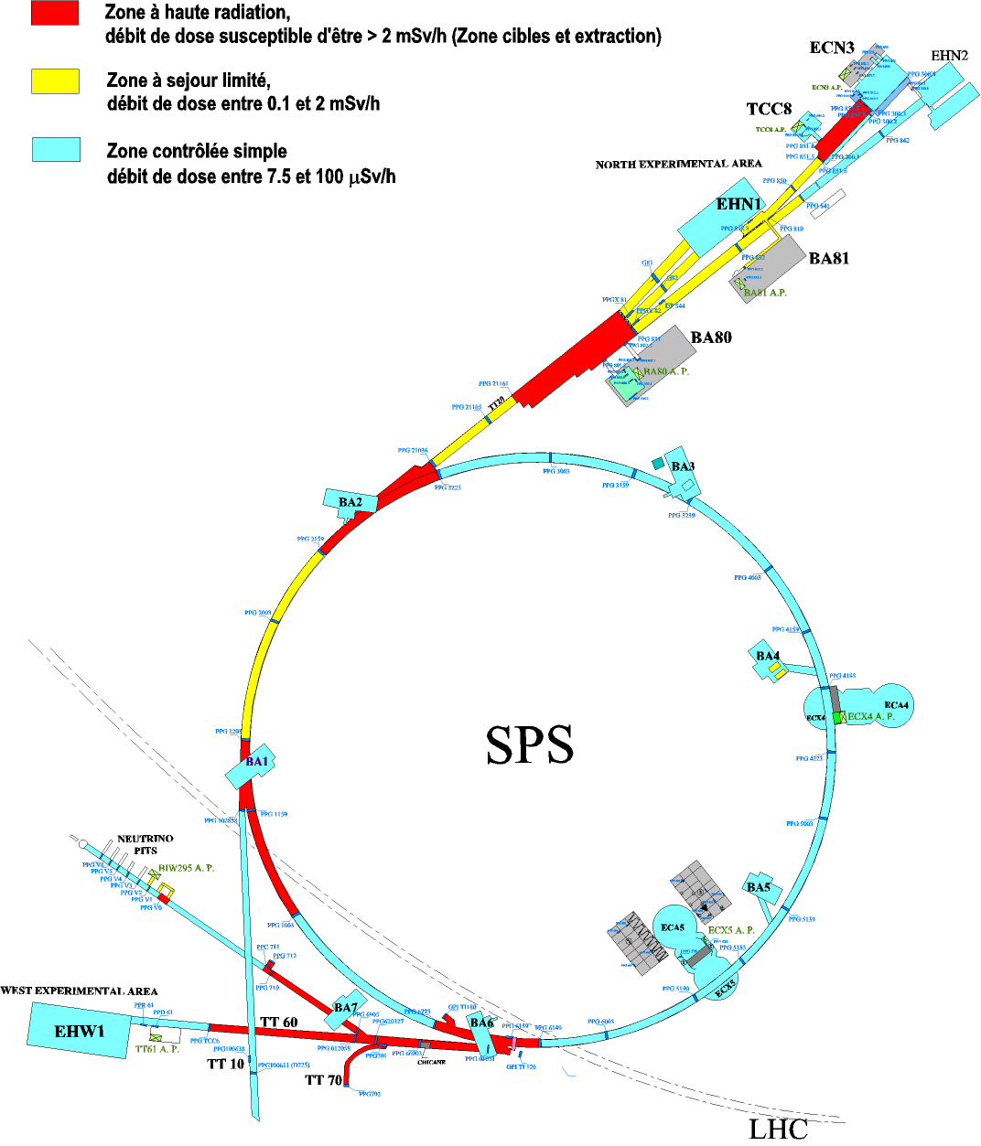
TT20 schematic
The targets T2, T4 and T6 are in this building
T2
T4
T6
TT23
TT24
TT25
SPLITTER 2
Entry at MSSB.220441
Stop at MSSB.220460
TT22
TT22
SPLITTER 1
Entry at MSSB.211713
Stop at BTV.211743
TT21

Slide 4
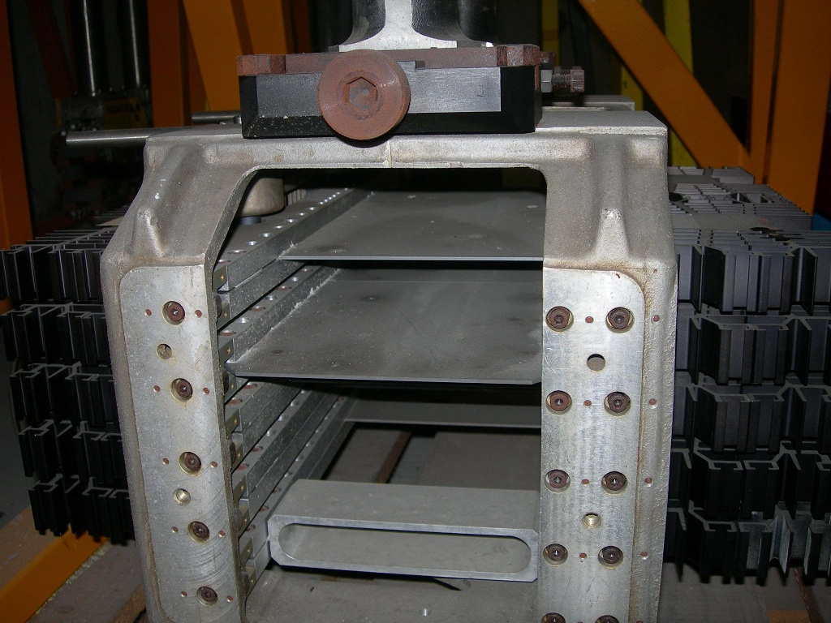
T2 target
The T2 target is 2mm wide
4

Slide 5
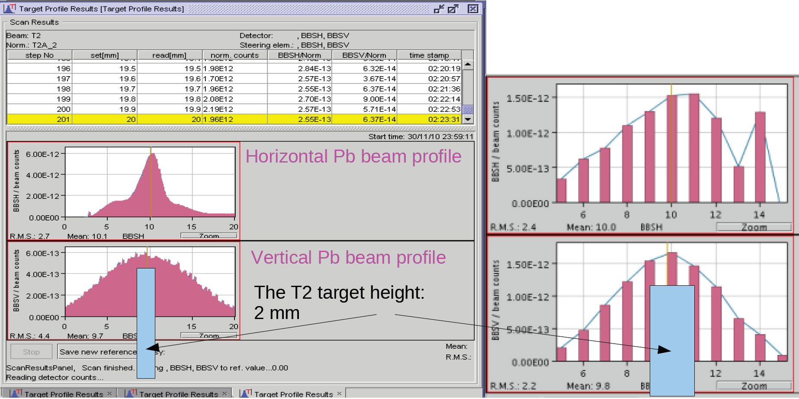
T2 Target
2010 optimization. Before and After. NA61 still needs
doubling of the intensity
on the T2 target !!!

Slide 6
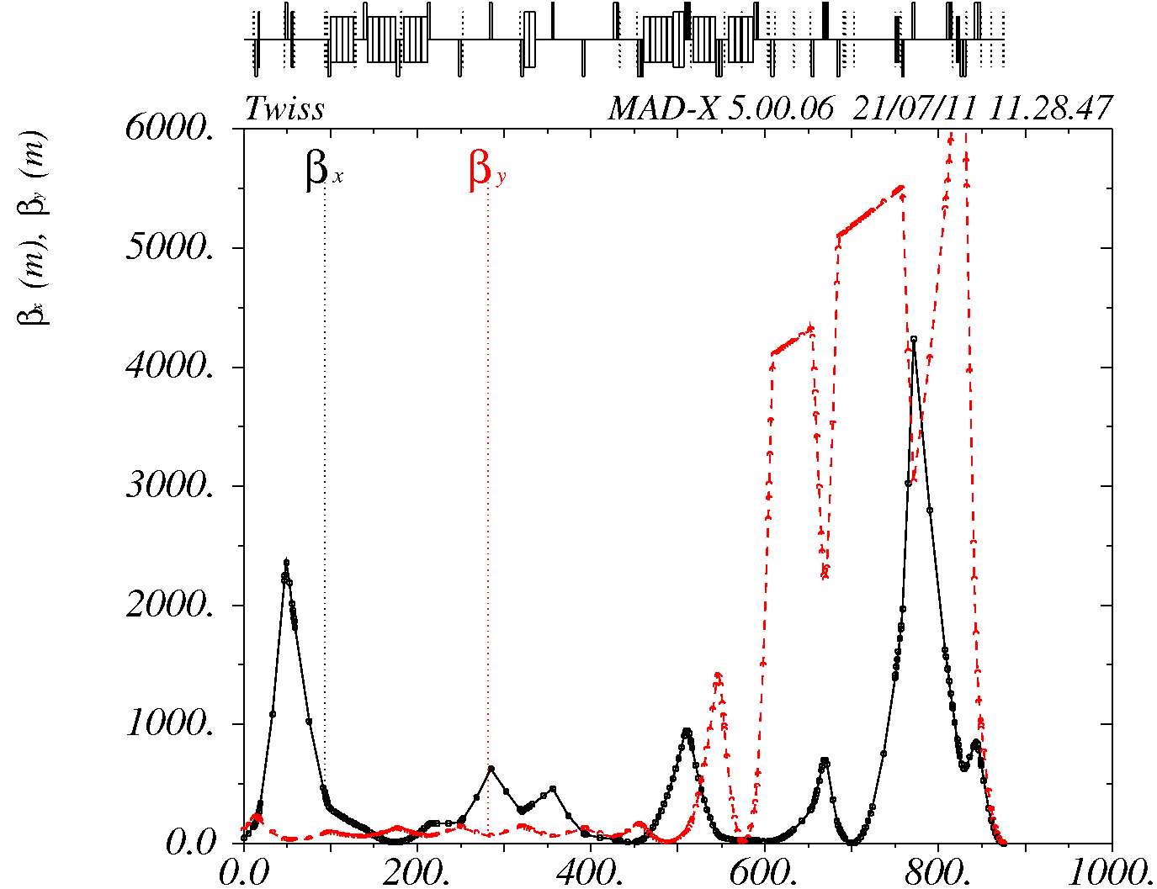
Simulation
The simulation predicts a one sigma spot-size of:
1.02 mm HOR
0.44 mm VER
We measure a full spot size of:
7 mm HOR (allow for factor 5)
8 mm VER (allow for factor 3.5)
THIS IS THE REASON FOR THE MD !!!

Slide 7

Simulation
What can go wrong in the simulation ?
Positions and strengths of quadrupoles not correct
Optical functions at extraction not correct
Dispersion is bigger in reality that in the simulation
Emittance is bigger in reality that in the simulation
Even if we do not find out why the simulation is wrong, we have other possibilities to reduce the spot size:
Find optimum for beam size:
Spot-size optimization can be made better, if limitations in aperture are not real. In this case we can get more degrees of freedom, which can be used to reduce the spot size.

Slide 8
Tests to be done
1. and 2. : Load different optics. Measure the beam profiles along the TT20 line.
Compare with simulations. This will determine the optical functions
at extraction and also determine differences in positions and
strengths of the quadrupoles.
Make a knob that can move the position of the spot upstream or
downstream of the T2 target.
Measure profiles at the T2 target for different spot positions.
Will give the correct position of the T2 target.
3. Measure transverse displacement of the beam at the T2 target, as a function
of the SPS energy.
From this measurement we can calculate the dispersion at the T2 target
4. Measure emittance in the SPS

Slide 9
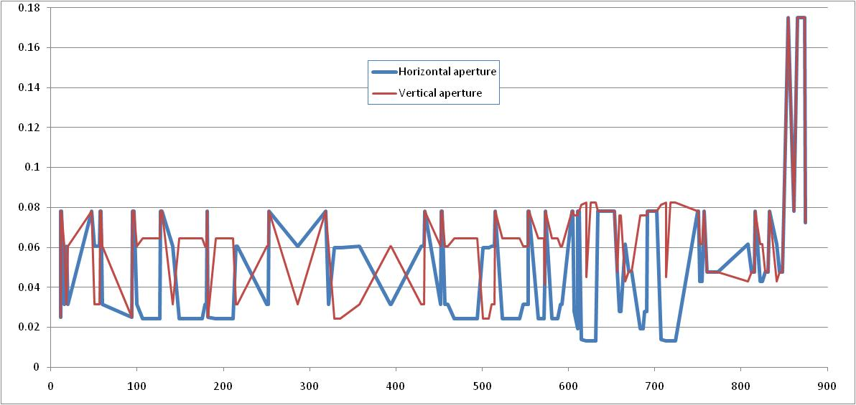
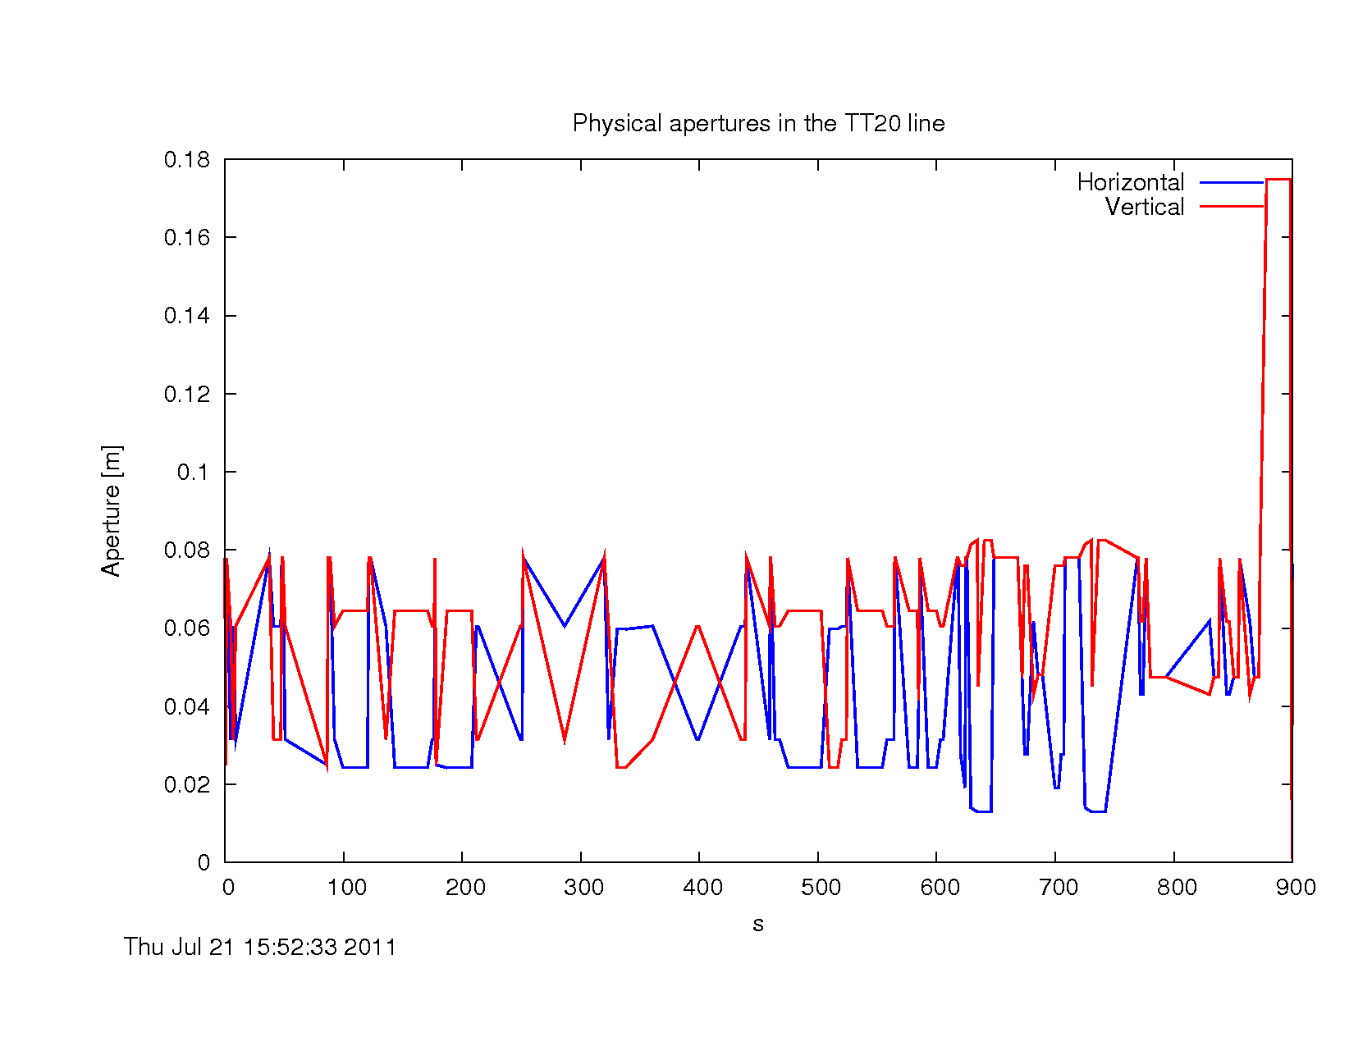
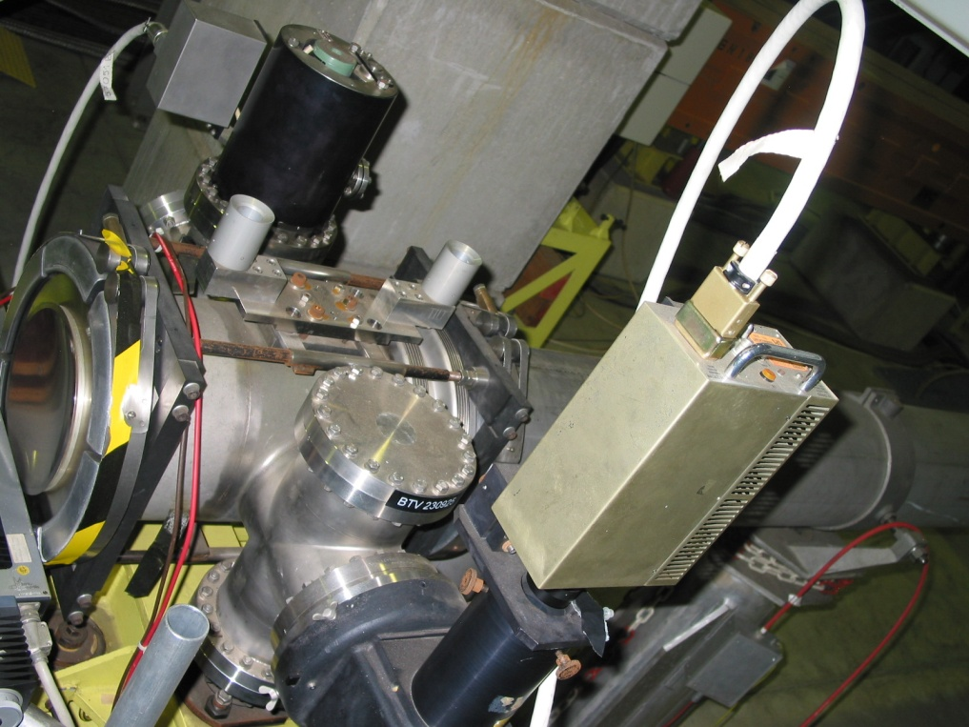
Tests to be done
Are aperture limitations real?
The aperture limitation from BTV.230925 did not really exist, but there are maybe other limitations that are not in our files:

Slide 10
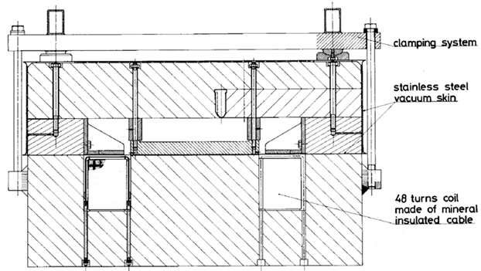
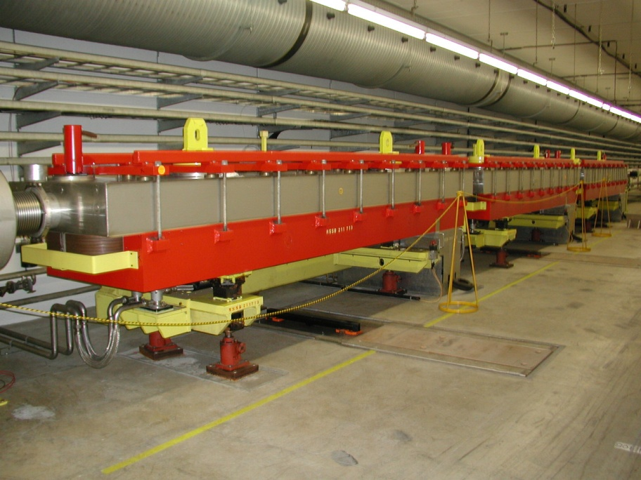
My worries
The different optics must be loaded into the operational database – before the MD!! The files will only be ready a few days before the MD. Only Jorg can load the optics. Will he have time enough?
Will the steering program work with the new optics?
This is important because the beam must be steered into the upper part of the SPLITTERs:

Slide 11
My worries
I do not know how to do the dispersion measurements ( by changing the energy in the SPS and measure the transverse displacement of the beam at the T2 target). Who can help ?
We need to reduce the intensity of the extracted beam to the TT20 line, because we do not want to shoot a hole in the vacuum chamber. Who can help?
Conclusion
Another MD is foreseen on 26 September, for the test of the final optimized optics.

