Slide 1
TT20 MDs for the NA61/SHINE fragmented beam experiment.
Made on 3 August and 29 August 2011
Friday 23/9 2011
O.Berrig
Thanks to G.Arduini, D.Manglunki, I.Efthymiopoulos, M.Gazdzicki(NA61) and members of the OP group (K.Cornelis, J.Axensalva, S.Massot, J.Wenninger)

Slide 2
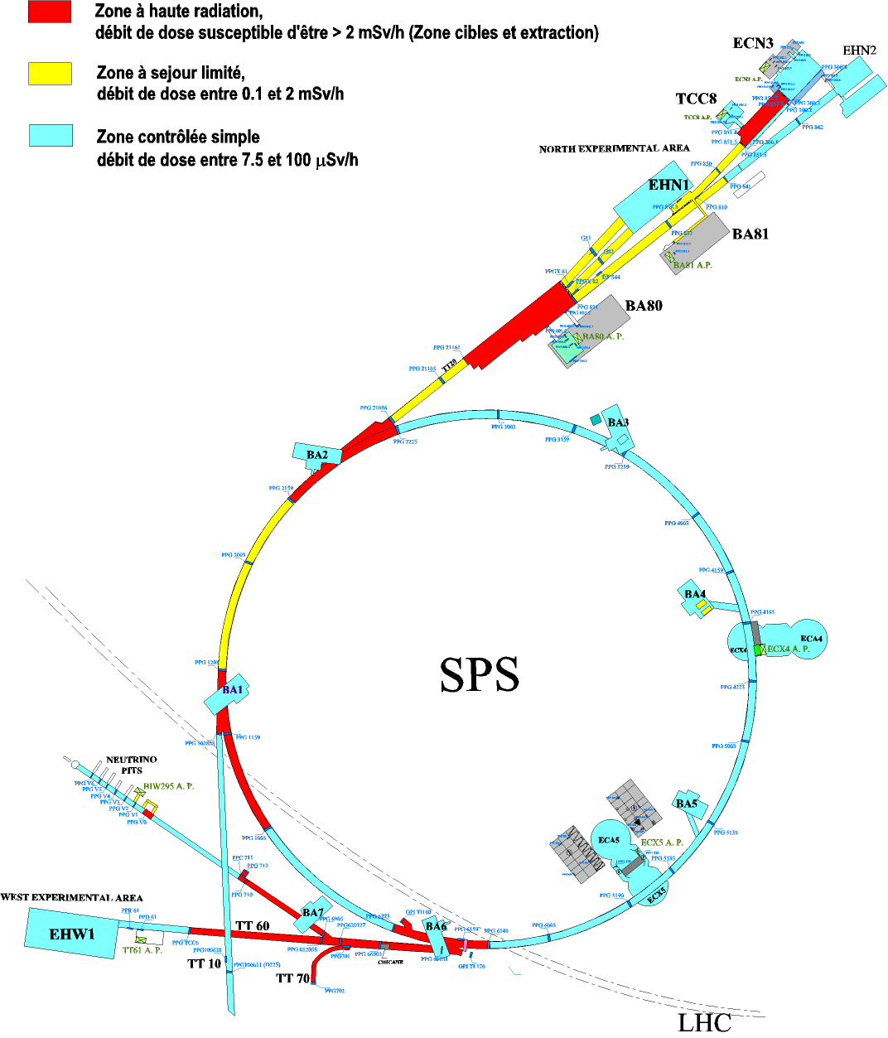
TT20 schematic
The NA61/SHINE experiment is in the North Area Experimental Hall
The targets T2, T4 and T6 are in this building
T2
T4
T6
TT23
TT24
TT25
SPLITTER 2
Entry at MSSB.220441
Stop at MSSB.220460
TT22
TT22
SPLITTER 1
Entry at MSSB.211713
Stop at BTV.211743
TT21

Slide 3
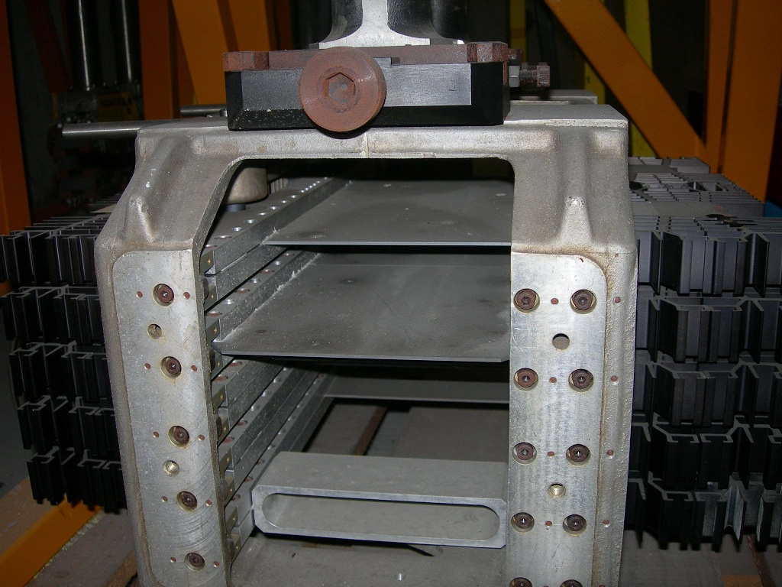
T2 target
The T2 target is 2mm wide
3

Slide 4

What was tested in the two MDs
Emittance
Kick / Response measurements:
determines quadrupole strengths, and quadrupole positions
3. Dispersion measurements
4. Implementation of knob, to move the focus on the T2 target
1 sigma beam size
Dispersion function
The b function depends mainly on the quadrupole strength and position
Special RF gymnastics is done in the SPS to reduce the energy spread, before extraction to TT20

Slide 5
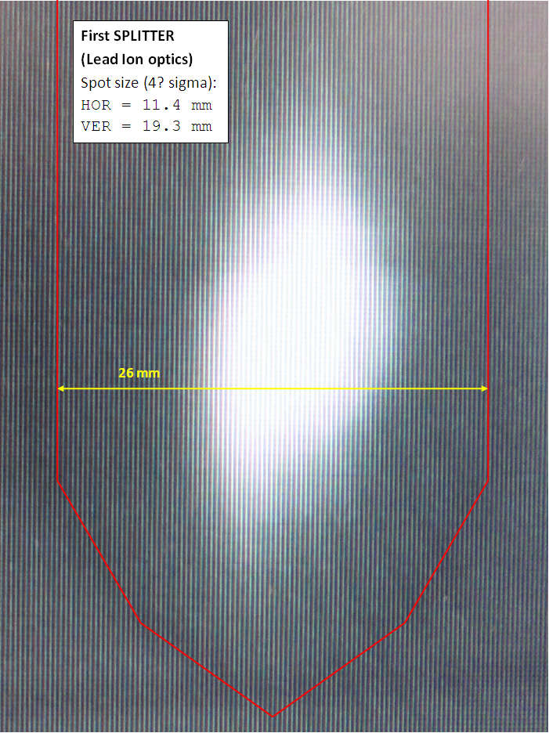
Emittance measurements - 1

Slide 6
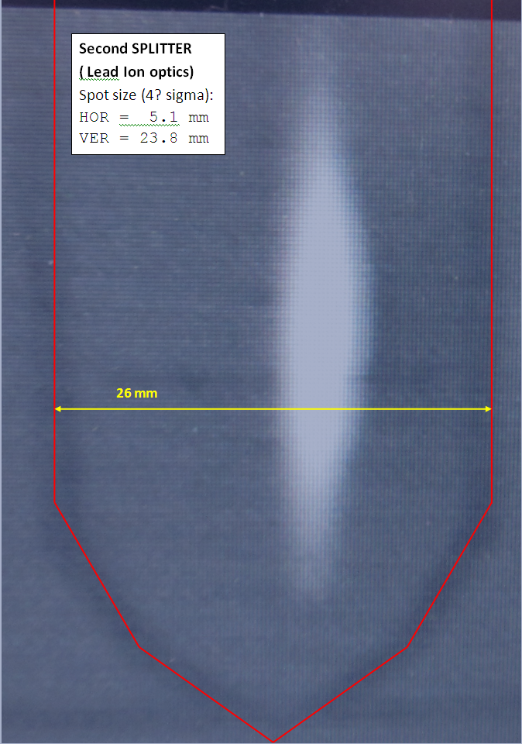
Emittance measurements - 2

Slide 7
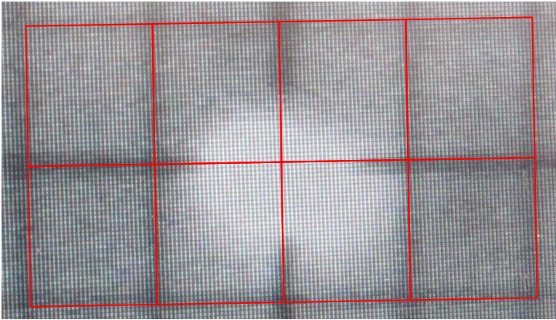
Emittance measurements - 3

Slide 8
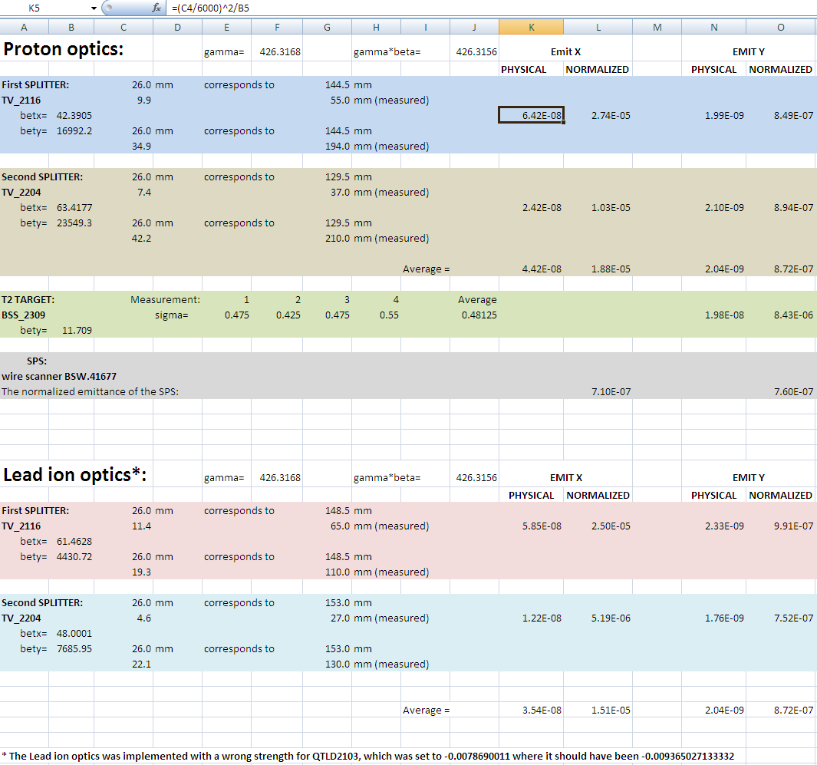
Emittance measurements - 4
The resonant extraction
( in the horizontal plane )
increase the horizontal emittance
Why is the emittance so big at the target ?
Extremely noisy measurements

Slide 9
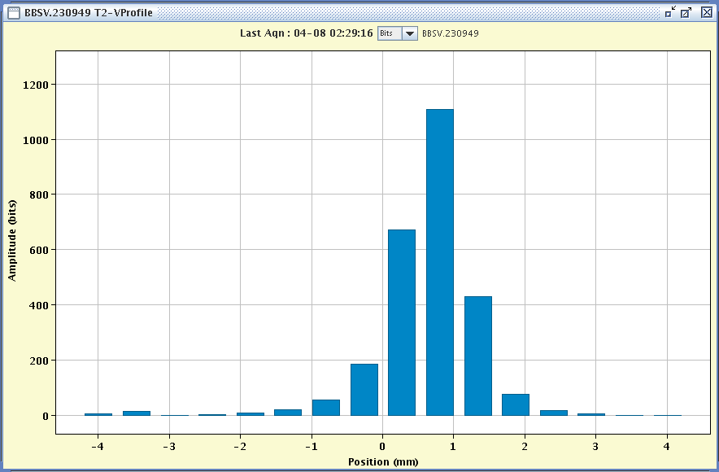

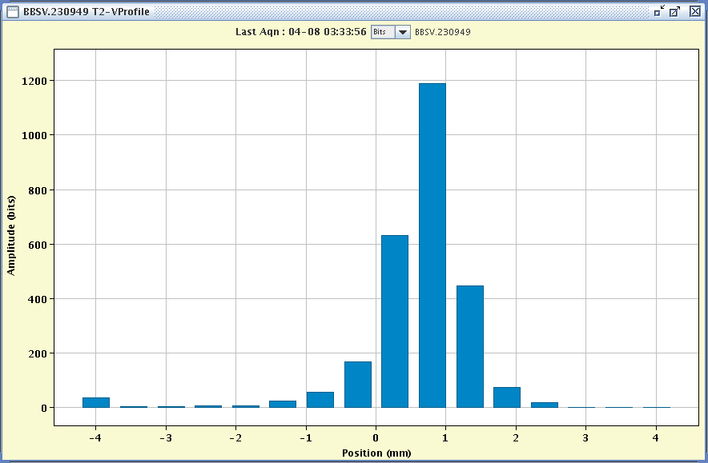
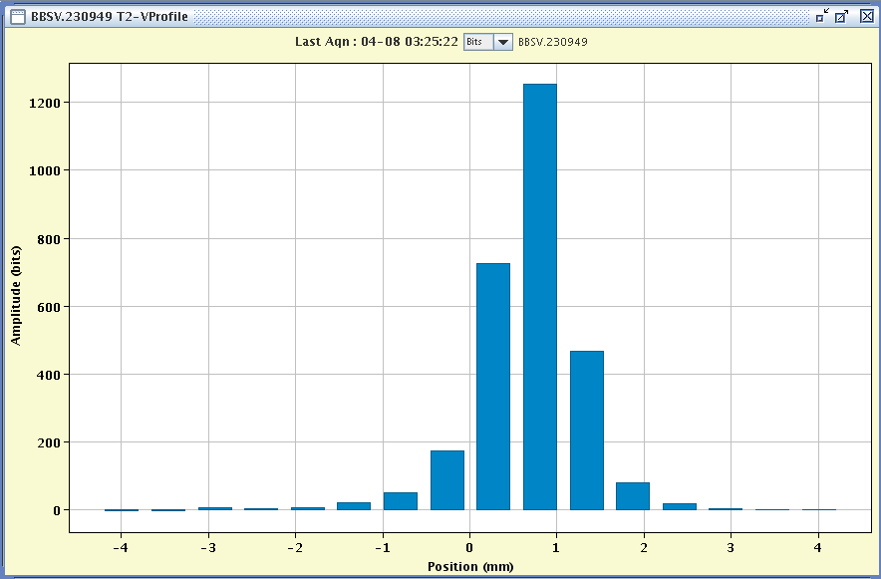
Implementation of knob to focus on target
“TARGET-LONG.DISPLACEMENT“.
Focus moved 10 cm upstream
Focus not moved
Focus moved 10 cm downstream
The vertical scans of the T2 target, were done for a LEAD ION optics that was badly implemented. This badly implemented optics predicts that moving the focus downstream would indeed narrow the beam size.
In the correctly implemented LEAD ION optics, there was no effect of moving the focus; This indicates that the focus was really a focus.

Slide 10
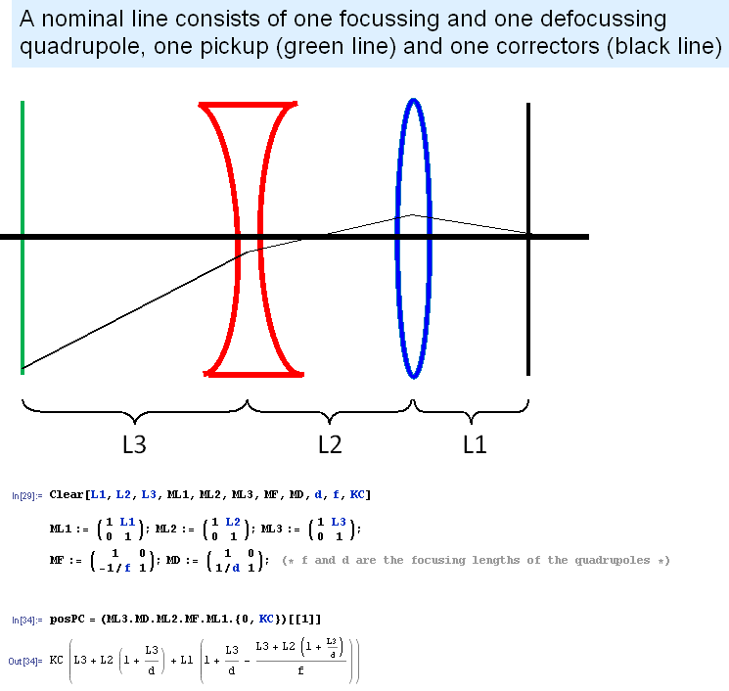
Kick / Response measurements - 1
A corrector gives a kick to the beam.
Measure the change of positions (at the Beam Position Monitors).
The positions are proportional to the kick.
Notice that the position is proportional to the kick of the corrector (KC)

Slide 11
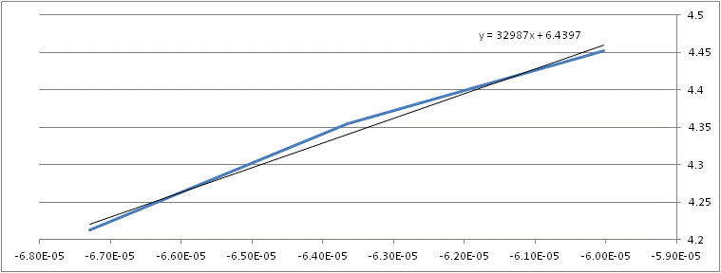
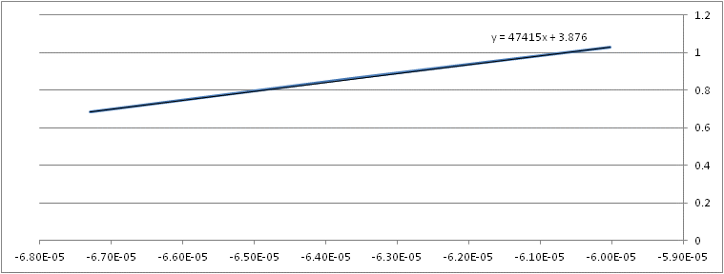
Kick / Response measurements - 2

Slide 12
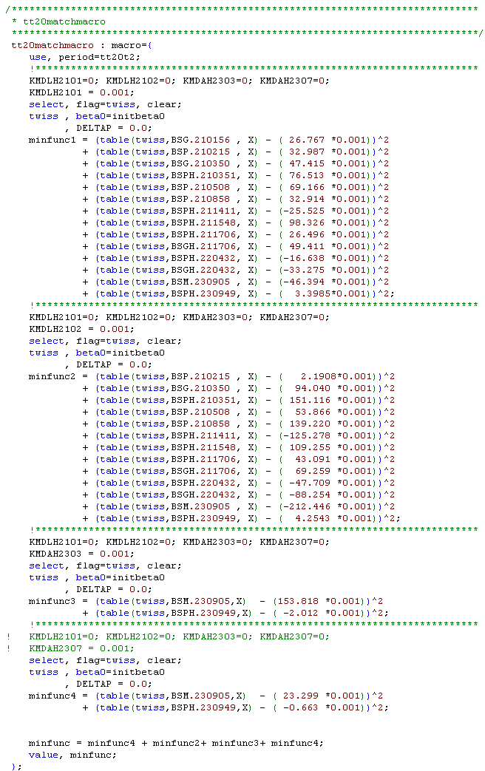
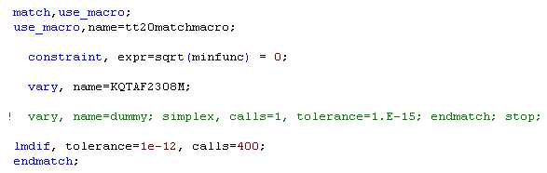
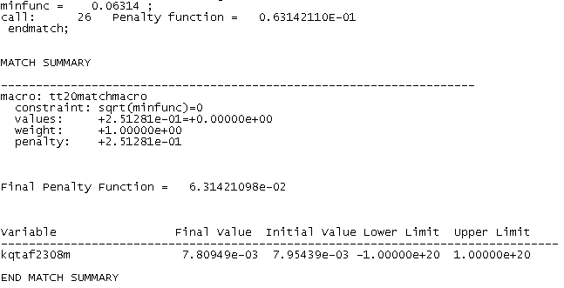
Kick / Response measurements - 3
Penalty function corresponds to an average error of a position measurement of 45 mm !!!!!!!!!!!!

Slide 13
Kick / Response measurements – 4 Steering Issues (slide from J.Wenninger)
There are special issues related to the split foils (BSPs) in TT20:
  The position must be reconstructed from the normalized signal difference of the two foils,
  Δ = (A-B)/(A+B)
  The conversion from Δ to the real position depends of the profile of the beam, i.e. shape and emittance.
  For steering it is assumed that the profile is triangular, and the emittance is a good (typical) guess Note that the TRUE emittance may vary with intensity and target sharing.
  If the beam is completely on one side (A or B) the signal remains constant independently of the real position → ‘saturation’ of the position.
  In the steering program a monitor that is saturated is indicated in YELLOW (WARNING !).
Steering is delicate in TT20… more than in LHC ??
Foil A
Foil B
A-B/A+B
+1
-1
Beam position
To ease life, a feedback (‘Autopilot’) can be run to automatically steer the beam on the target. But this works only to the last 2 monitors !

Slide 14
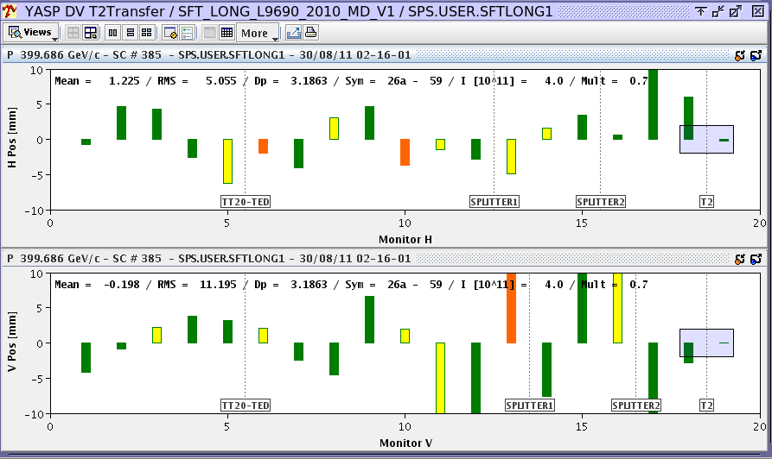
Kick / Response measurements - 4
Several SEM foils were saturated (YELLOW) !!

Slide 15
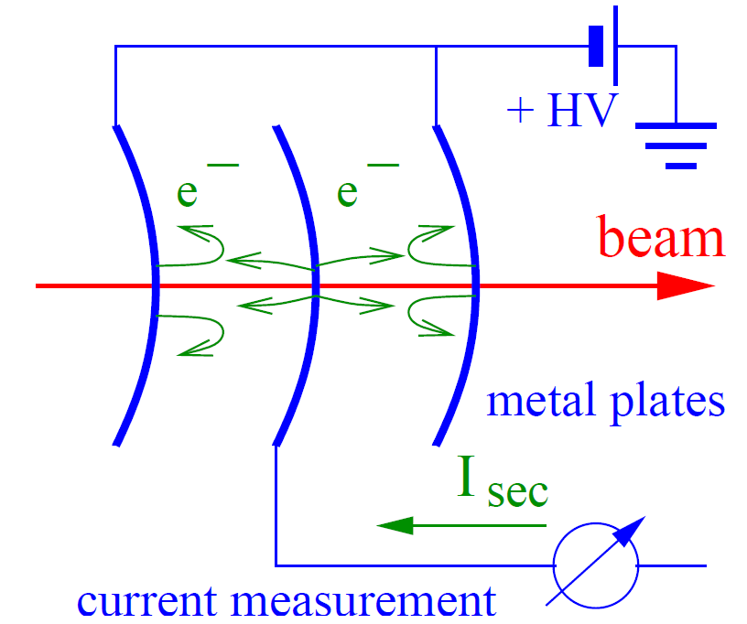
Kick / Response measurements - 5
Functioning of a SEM foil

Slide 16
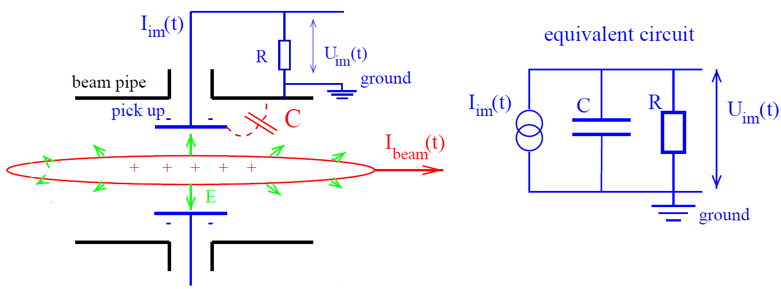
Kick / Response measurements - 6
Functioning of a Beam Position Monitor

Slide 17
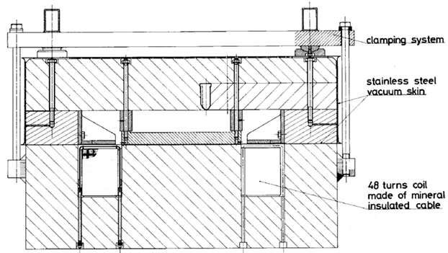
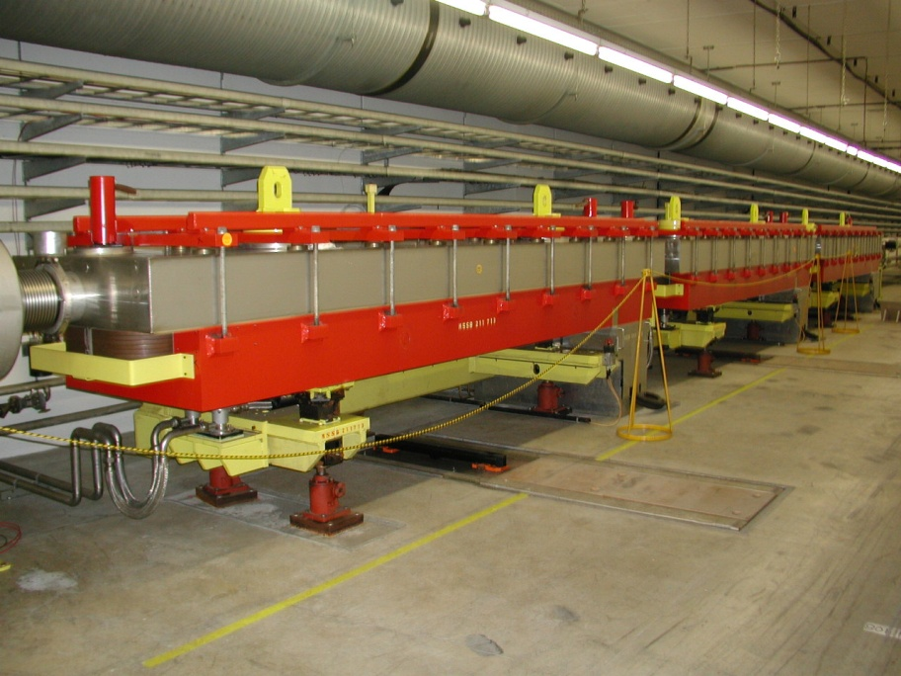
My worries
The different optics must be loaded into the operational database – before the MD!! The files will only be ready a few days before the MD. Only Jorg can load the optics. Will he have time enough?
Will the steering program work with the new optics?
This is important because the beam must be steered into the upper part of the SPLITTERs:

Slide 18
Conclusion – part 1
1. Because of the poor precision of position measurements with the SEM foils, neither the kick / Response measurements nor the dispersion measurements had enough precision to verify the optical model. Also the emittance measurements had too many guesstimates to verify the optical model of the TT20 line. Again, because of the poor precision of the position measurements, the automatic steering of the TT20 line does not work. Only the steering around the T2 target works.
During the setup of the TT20 line with LEAD IONS, I will try to implement several optics that are supposed to have a smaller vertical size at the T2 target.
Is it possible to put the SEM foils in an OUT position?
Together with B. Mikulec and V. Raginel we are developing a new Kick / Response method, which also changes the strengths of the quadrupoles.

Slide 19
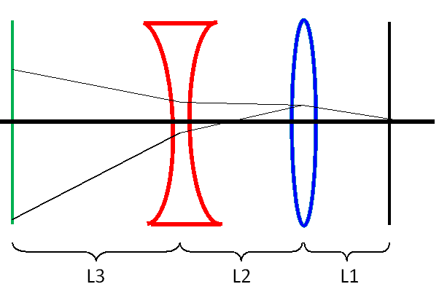

By changing the strength of the focusing quadrupole, it will play the role of a corrector.
The strength of the equivalent corrector is
Similarly the de-focusing quadrupole, can also play the role of a corrector.

Slide 20
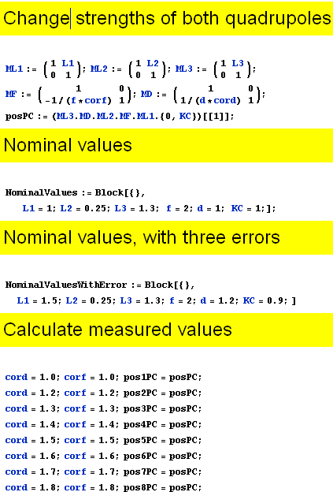
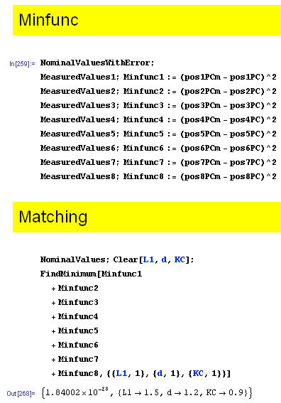
By simultaneously changing the strengths of the focusing and de-focusing quadrupoles, we can obtain an infinite number of equations, example:

Slide 21
Conclusion – part 2
When the new Kick / Response method have been proven,
I will be back to ask for more MD time in the TT20 line

