Slide 1
PS Machine Changes during the
2009 Shutdown
R. Steerenberg
With thanks to Simon Mataguez, who carefully maintains the shutdown logbook.
Shutdown Lecture
12 March 2009

Slide 2
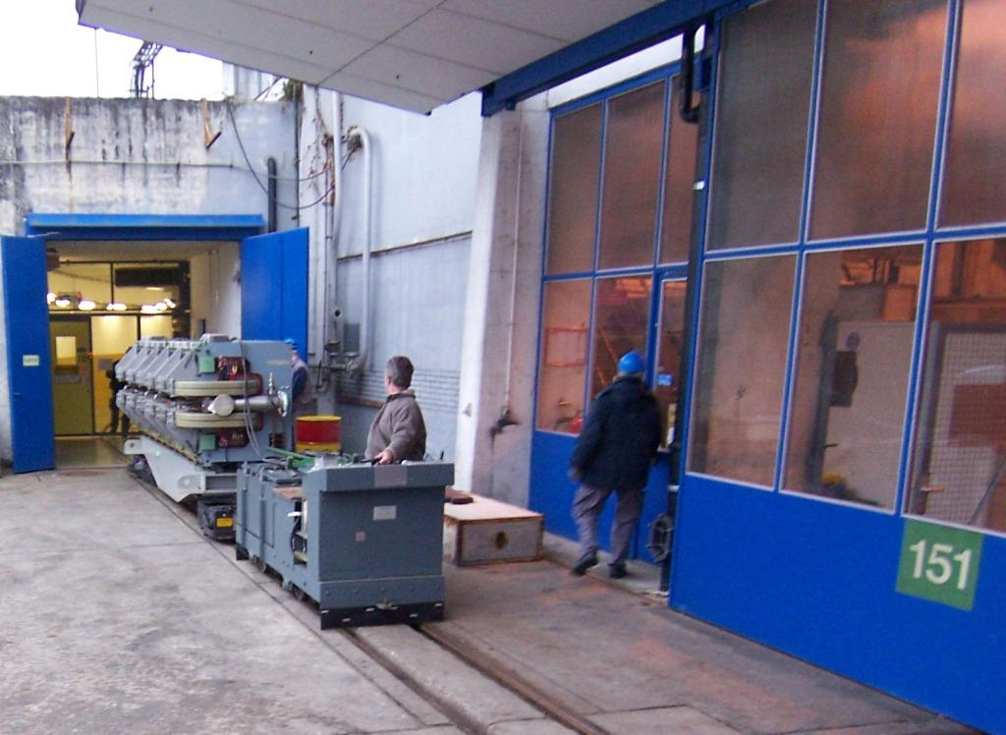
Main magnet renovation
The first phase of the Main Magnet Unit renovation finished last shutdown. Now we have 51 renovated magnets in the machine
The main magnets that were moved out and in the machine and have been renovated last shut down are the following
  R-type: 26, 70, 72
  S-type: 99
  T-type: 23, 65, 69
  U-type: 58, 68
  4 renovated spares available
We will do a beam based realignment.
MMU25 8-loop was repaired without moving the magnet

Slide 3
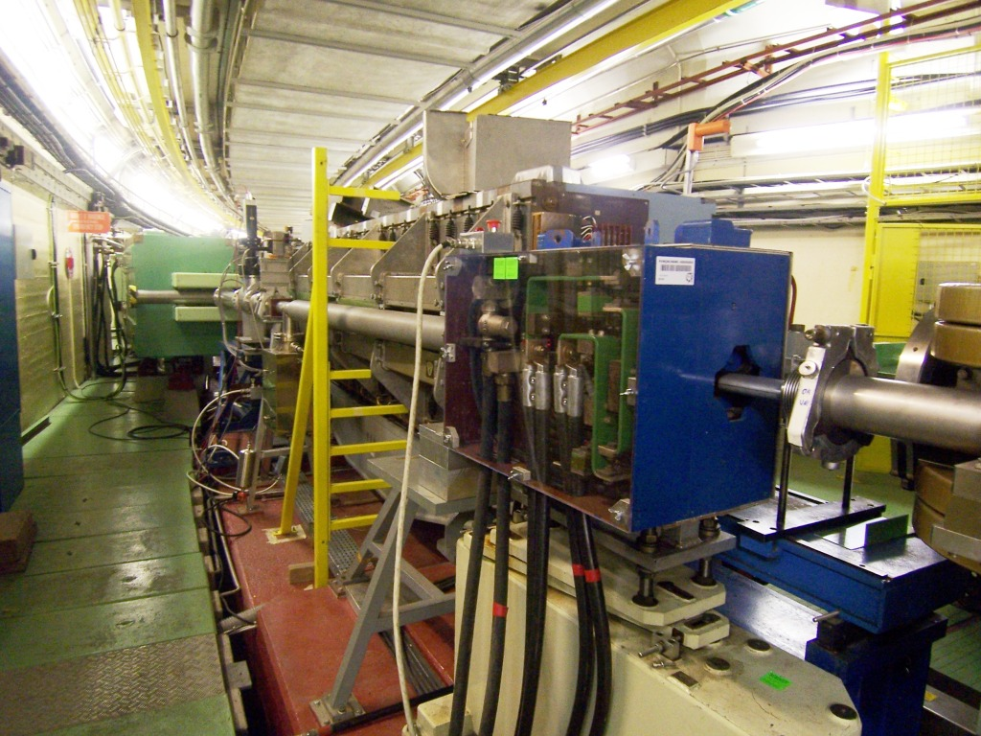
F16.QFO105 and vacuum chamber
The vacuum chamber in the QFO105 was changed
The QFO105 spare magnet is now installed

Slide 4
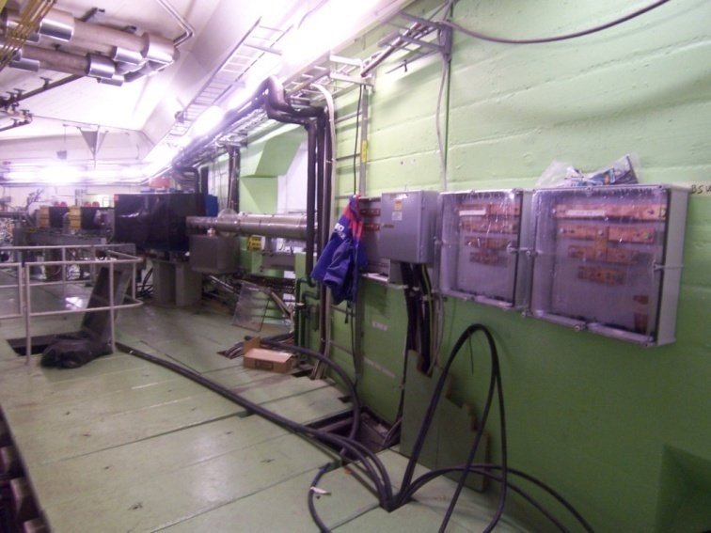
Building 365 re-cabling work
The patch panels in building 365 were removed and new cables go now directly from the power converter to the magnets
This means that also all the interlocks have been re-cabled
The elements concerned are:
  QSE, XSE, BSW23, BSW57
  BSW31
  QKE16, QKE16-25, QKE16-73
  ODE
  Triplets
  Doublets

Slide 5
New power converters
New power converters, replacing the old TEKELEC’s, were installed for the following magnets/circuits in building 365:
  ODE
  QSE, XSE, BSW23
The Power converter for the BSW57, which was operated at the limit of the rms current of 200A was upgraded to 400A

Slide 6
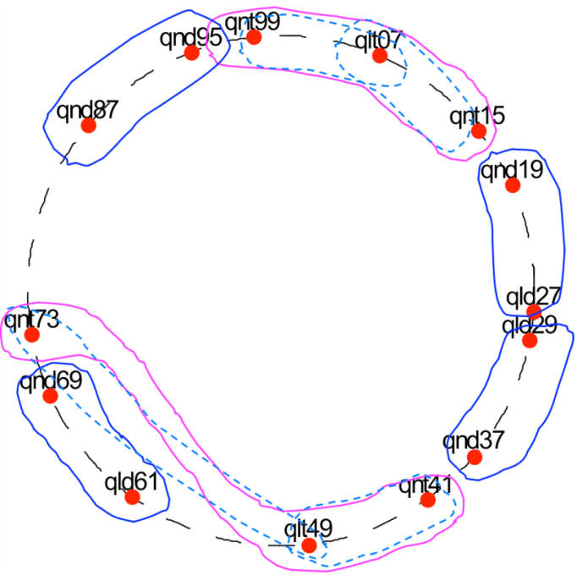

Doublet circuits
The doublet circuits have been re-cabled in the ring to allow a different balancing
Configuration 2009:
  A: 19, 27 and 87, 95
  B: 29, 37 and 61, 69
Configuration 2008
Configuration 2009
B
A
Triplets
A
Triplets
A
Doublets
Doublets
A
B
B
B

Slide 7
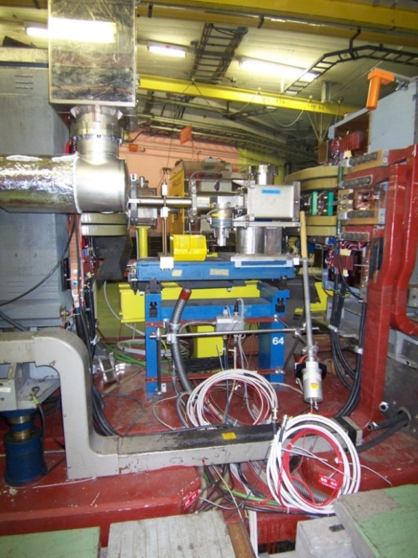
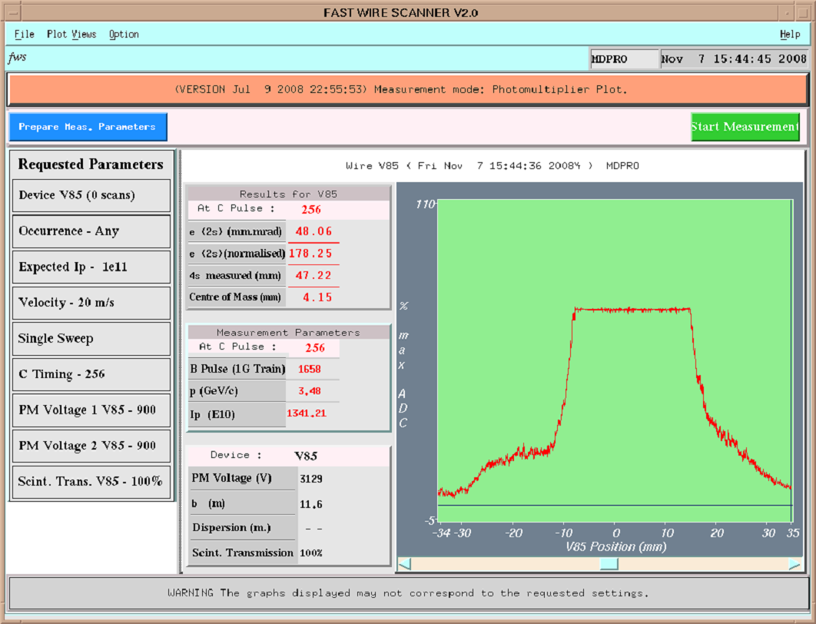
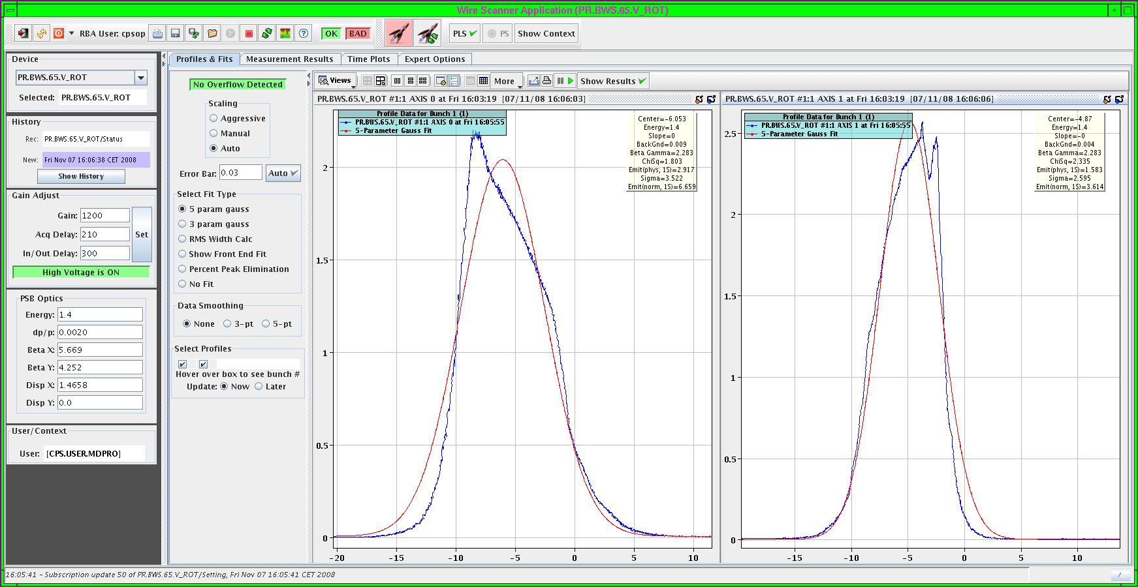
Fast Wire Scanners
Fast wire scanners:
  New electronics, FESA class and application for the PS fast wire scanners.
  See presentations of Ana and Elliot
  Special MTE island Peak fit is under development by Jean-francois Comblin
  No analogue signal on OASIS for the moment
FWS H54, H64, V65 and V85 are available and calibrated
The installation of the FWS in 75 for MTE was cancelled
saturated
saturated

Slide 8
SEM-grids upgrade
In/out movement was renovated and is now controlled by PLC from building 365. (CFP-365-GRID)
This renovation means replacement of the GM class by a FESA class and the use of the new JAVA application made by Jean-Francois Comblin
The equipments concerned are:
  PR.MSF42,48,52,54, H et V, et du ralentisseur PR.RAL 12
  The SEM-grids and SEM-fils in the TT2 line are prepared, but not yet implemented on OP request. The old system in combination with the old application provides ABS and the new does not

Slide 9
BBQ
See also presentation of Marek Gasior
The new system was adapted to have better performing means of exciting the beam
  Chirp now adjustable in frequency range and amplitude
  One turn kick is re-introduced
There are now two systems installed, but only one front end
  Pickups in SS69 and SS72
Marek can connect either of the two systems
  Advantage in case of break down
  Advantage as new development can be tested without compromising the operational system

Slide 10
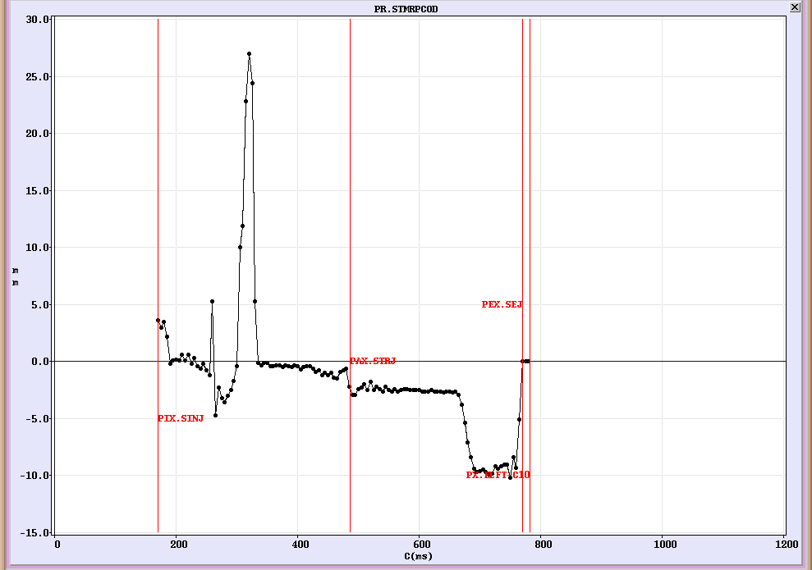
RF Radial loop
The radial loop uses 3 CODD style pick ups in SS22, 51 and 96
There has always been a difference between the CODD MRP and the RF MRP due to the fact that the position of the pickups was not optimum
This shut down a 4th pickup was added with the aim to better center the beam in the machine and to reduce the difference between CODD MRP and RF MRP
This pickup, which is situated in SS76, will not be active immediately, but can be enabled at will. MD’s will take place before activating it

Slide 11
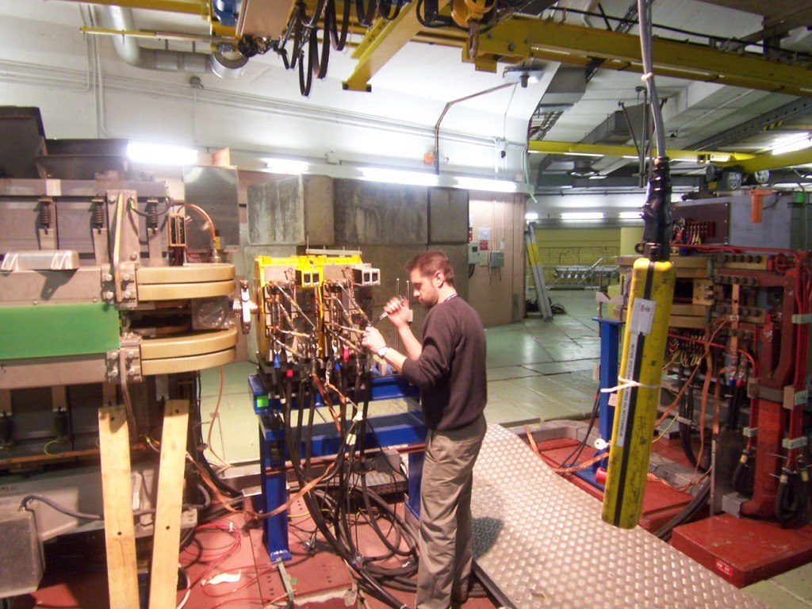
Vacuum chamber SS01
The SS vacuum chamber is now made of 2 parts in order to avoid having to open the MTE sextupoles every year

Slide 12
Other:
Main power supply with FGC control
  See presentation Jean-Paul Burnet, Quentin King and Pierre Freyermuth
  New simulated B-train hardware
The power converters of SMH16 and SMH26 were moved from building 367 to building 359
  As a consequence the cabling was redone
Vacuum control was renovated
  Naming of equipment was reviewed and is different
  Control now via PVSS (linux version)
  Pressure reading should remain available in WS
Two additional OTR screens are installed in the TT2 line
  F16.MTV229 and F16.MTV241
CODD pickup gains have been redistributed and recalibrated
  Gain control will become apart to have compatibility between CODD and new orbit measurement system
TT2 (SPS) pickups will be on samplers

Slide 13
Potential issues:
Main magnet 63 make a sighing noise, which is for the moment not understood.
  It is no obstacle in the vacuum chamber, that was checked
QSK57 will not be available as there seems to be an interruption in the 400 meter cable.
.......
This list is surely not exhaustive, any additional information is welcome and will be added.

