Slide 1
ELENA Tracking studies
P.Belochitskii, O.Berrig
With thanks to: C.Carli, L.Varming Jørgensen, G.Tranquille

Slide 2
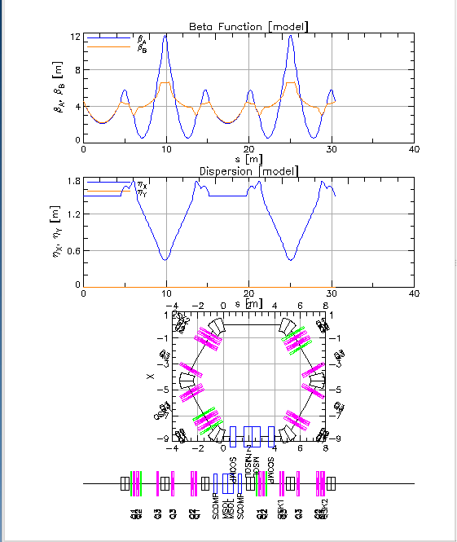
BMAD – an alternative tracking program
BMAD is a program from Cornell by D.Sagan. It is symplectic ( which basically means energy conservation: http://en.wikipedia.org/wiki/Symplectic_integrator), and has the added capability of tracking through user defined fields. Since the electron cooler is described by a field map (and the space charge from the electron beam also) it would have been a fine candidate for ELENA.
However there were some issues with the running of the program (that has been solved later) which at the time discouraged us from using BMAD.
Plot of the ELENA ring; made by BMAD

Slide 3
MADX does not calculate correct tunes for off-momentum particles
Even though tunes, chromaticities, etc. are not calculated correctly in MADX, the tracking in MADX is the same as the tracking in PTC up to second order (but only for on-momentum particles; for off-momentum particles there are errors in MADX)
See: http://cern-accelerators-optics.web.cern.ch/cern-accelerators-optics/OtherInfo/MADX_PTC_BendingMagnet_difference_14Nov.doc
All simulations were therefore done with PTC
MADX
PTC

Slide 4
How to simulate the space charge generated by the electron beam?
The electron beam makes de-focusing of the antiprotons in both planes; This process cannot be simulated by PTC. MADX however, can do simulations with an arbitrary MATRIX element – but only for thin lens optics.
We made a model of ELENA with thin lens, however the beta-functions were not perfect.
Because of the following arguments:
In order not to spend too much time optimizing the thin-lens beta-functions (which would in any case always represent an approximation).
The MATRIX element of MADX only simulate the effect on the protons that are inside the radius of the electron beam, but not the protons that are outside.
MADX is only precise to second order.
We decided to simulate the electron cooler with Mathematica and the rest of the ring with PTC

Slide 5
It was decided to run without the main sextupoles
magenta=10mm, green=20mm, red=30mm, blue=40mm, orange=50mm
Without sextupoles
With sextupoles
The simulations on this page were done with the electron cooler simulated with MADX solenoids (the electron beam was not included).
The strength of the sextupoles was nominal, i.e. set to make the chromaticity equal to zero, so that off-momentum particles will not touch neighboring resonances
Since the sextupoles brought too much non-linearity (leading to loss of particles with 50mm amplitude) we decided to temporarily switch off the main sextupoles in order to concentrate on resonances from the rest of the machine (especially the electron cooler)
Horizontal
Vertical

Slide 6
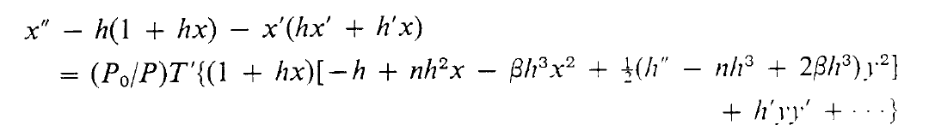
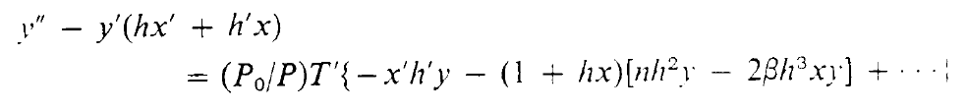
Philosophical interlude (1)
There are no linear magnets, not even quadrupoles and bending magnets.
In reality they contain non-linear elements like sextupoles and octupoles and up to any higher order mode. This is not only because the fringe fields at the end of the magnets are non-linear, but even the magnets themselves. See: http://zwe.home.cern.ch/zwe/talks/cern_nonlinear.pdf
A bending magnet contains e.g. sextupolar components (the larger the bending angle, the larger the sextupolar component). This was already discovered by Karl Brown in 1982: http://www.slac.stanford.edu/cgi-wrap/getdoc/slac-r-075.pdf :
HORIZONTAL motion:
X²-y² is a sextupolar component:
D[P[x, y], x]
D[P[x, y], x]
VERTICAL motion:
x·y is a sextupolar component, see J.Jowett:
\\cern.ch\dfs\Projects\ .. \MultipoleFields.nb
For a bending magnet,h is equal to 1 divided by the bending radius: h=1/r

Slide 7
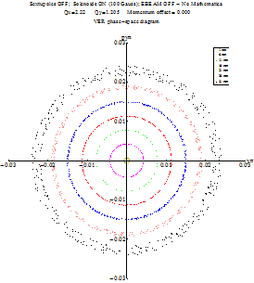
Compensation of sextupolar component in the main magnets
NO compensation
With compensation
sextupole

Slide 8
Compensation of sextupolar component in the main magnets
NO compensation
With compensation
sextupole
2*Qx-Qy

Slide 9

Philosophical interlude (2)
Any machine with non-linear elements will couple the horizontal and vertical planes and lead to lines in the tune diagram that should be avoided:
Avoid tunes that fulfill the equation:
where: l,m and r are integers
See page 69 in http://cds.cern.ch/record/212880/files/CERN-92-01.pdf See also: http://cern.ch/bruening/CAS/Driven_Resonances.ppt
and: http://cds.cern.ch/record/1694484/files/CERN-2014-002.pdf

Slide 10
Qx=2.22 Qy=1.205
Qx=2.26 Qy=1.29
Qx=2.28 Qy=1.30

Slide 11
Biggest problem. Vertical emittance is growing – why?
No shielding – No correctors
With shielding – With correctors
Observe first that there is coupling between the horizontal and vertical planes (Q_{x}-Q_{y} = 1). The signatures of this resonance are seen in the FFT plots (next slide) and in the variations of W_{x} and W_{y} versus turn; when one of them is on the crest, the other is in the trough - but amplitude of variations is different for x and y-planes. On top of that, in the vertical plane W_{y} is growing with number of turns!

Slide 12
Biggest problem. Vertical emittance is growing – why?
No shielding – No correctors
With shielding – With correctors
No essential difference in the tune spectra, except for the presence of the linear coupling resonance Q_{x}-Q_{y} = 1.
But coupling cannot increase the emittance in one plane and not in the other!

Slide 13
Biggest problem. Vertical emittance is growing – why?
Other observations:
The electron cooler field without shielding and without correctors is a theoretical calculation followed by a Mathematica interpolation at a given particle position. The electron cooler field with shielding and with correctors is calculated by OPERA with a given mesh; for tracking we again use Mathematica with interpolation at a given particle position.
The curl (=rotB) of the electron cooler field without shielding and without correctors is much smaller than for the electron cooler field with shielding and with correctors
Summary:
solenoid (without shielding and without correctors) with 2.5 mm spacing; the rot B amplitude is 0.0000022
solenoid (without shielding and without correctors) with 5 mm spacing; the rot B amplitude is 0.0000230
solenoid (without shielding and without correctors) with 10 mm spacing; the rot B amplitude is 0.0001600
solenoid (with shielding and with correctors) with 3 mm spacing; the rot B amplitude is 0.0090000
solenoid (with shielding and with correctors) with 5 mm spacing; the rot B amplitude is 0.0650000
It was also tried to calculate the fields with tetrahedral mesh, but no improvement:
solenoid (with shielding with correctors TetraMesh) with 1 mm spacing; the rot B amplitude is 0.0200000
solenoid (with shielding with correctors TetraMesh) with 2 mm spacing; the rot B amplitude is 0.0190000
(NB! both fields were calculated with the same mesh with a grid size of 2 mm)
The vertical emittance growth depends on the working point. The vertical emittance grows slower for WP (2.26 ; 1.29) than for WP (2.28 ; 1.30).

Slide 14
Conclusion (1)
We found that the main bending magnets have strong sextupolar components. We compensated for these by placing sextupoles (with opposite polarity) around the main bending magnets.
We simulated several working points
We simulated off-momentum particles
Problem:
The vertical emittance is growing. Hypothesis: Numerical imprecision in the electron cooler field (simulated with OPERA; which is a standard program in CERN for simulating magnets)

Slide 15
Conclusion (2)
Things to do:
Understand the problem with the vertical emittance growth
Possibly solve the problem with the vertical emittance growth by making an extremely fine mesh in OPERA
Do the simulations with space charge, in order to see the effect of the electron beam.
Documentation – how to use Mathematica tracking inside PTC. It is a fairly simple and modular setup.
Nice things to do:
Fully compensate the main bending magnets. The compensation with the sextupoles significantly reduced the coupling in the machine; however quite some coupling remains, especially at large amplitudes. Is the remainder of the coupling linear ?
Run ELENA as a transfer line. See what compensation gives the best closed orbit solution
Decomposition of the magnetic field in the electron-cooler field into thin lenses

Slide 16
ELENA tracking project:
http://project-ps-optics.web.cern.ch/project-PS-optics/cps/ELENA/2014/
Tracking with MADX/PTC:
http://project-ps-optics.web.cern.ch/project-PS-optics/cps/ELENA/2014/cmd/tracking.madx
Tracking with Mathematica:
http://project-ps-optics.web.cern.ch/project-PS-optics/cps/ELENA/2014/cmd/tracking_with_field_192cm.madx

