Slide 1
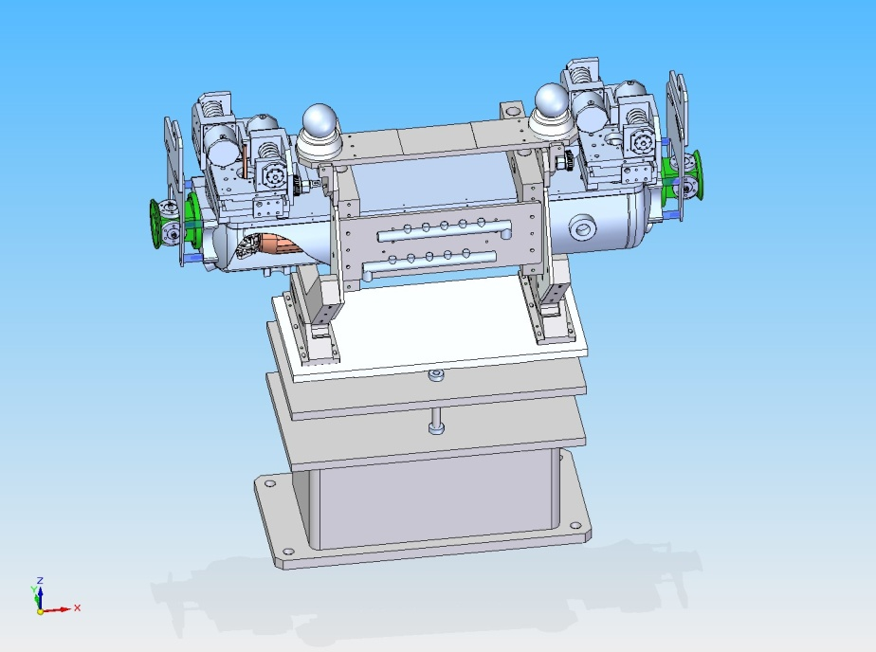
LARP Phase II Secondary Collimator RC-1
BPM Interface
Revised 1/23/10
LARP LHC PHASE II COLL RC1 - S. Lundgren 21 Sep 2009 No 1/17

Slide 2
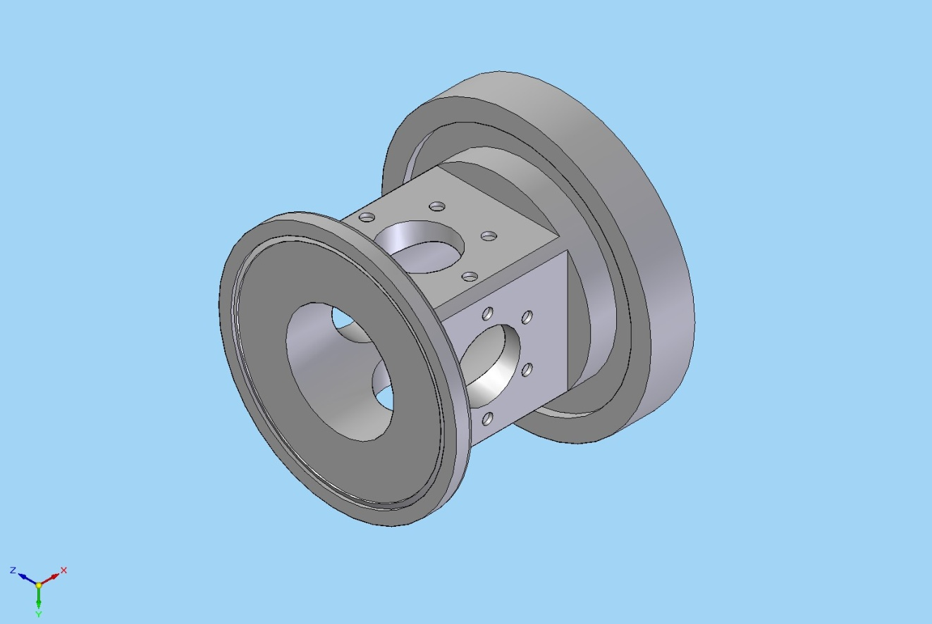
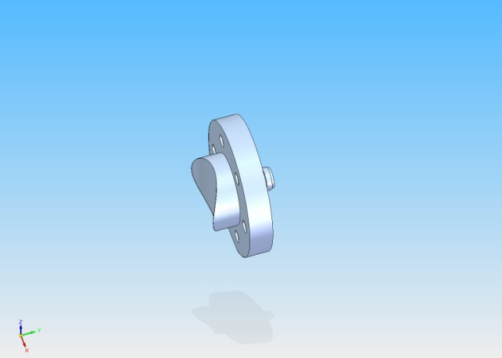
Current housing concept for BPMs
BPM target resolution is 25 microns with Jaw
to BPM fiducialization on the order of of a few microns
DN 152 CF flange mounts to Tank
DN 100 Chain clamp flange
LHC IR7
Button
61mm diameter geometry for saddle-cut 30.5mm diameter BPM buttons
LARP LHC PHASE II COLL RC1 - S. Lundgren 21 Sep 2009 No 15/17

Slide 3
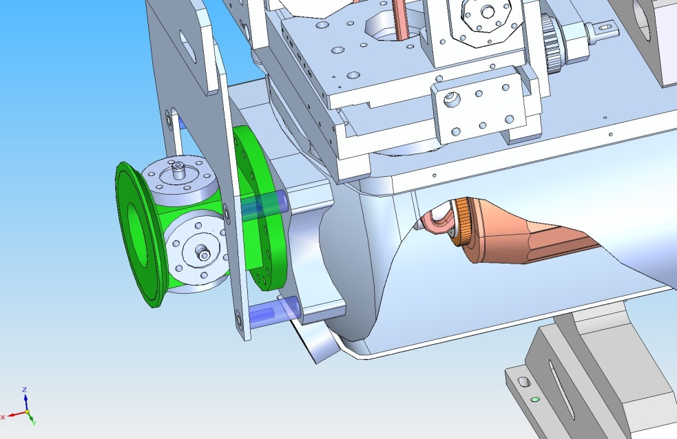
BPM Attachment to Tank
Chain Clamp Flange
Flange ID is welded to Tank (has bottom tapped holes)
Flange also supports the lifting fixture
Bolted Flange
LARP LHC PHASE II COLL RC1 - S. Lundgren 21 Sep 2009 No 17/17

Slide 4
Conflat Flange features are machined after welding
Fit check of Flange with Tank end curvature

