Slide 1
Simulations of the H⁻ charge exchange injection into the PS Booster with Linac4
Matthias Scholz

Slide 2
Table of contents
Brief introduction
Motivation for Linac4
H⁻ charge exchange injection
Compensation schemes
Simulations

Slide 3
Table of contents
Brief introduction
PS Booster, Linac2 and Linac4
Motivation for Linac4
H⁻ charge exchange injection
Compensation schemes
Simulations

Slide 4
Introduction
A new linear accelerator, Linac4, will replace the currently used Linac2 in 2015.
Linac4 could become the low energy part of the proposed SPL.
The injection to the PS Booster will change from 50 MeV protons to 160 MeV H⁻ ions.
The Booster is the first synchrotron in the LHC proton injection chain and accelerates protons up to 1.4 GeV.
The conventional multi turn injection will be replaced by a H⁻ charge exchange injection.
Additional focusing effects will occur and have to be compensated.

Slide 5
Table of contents
Brief introduction to the accelerators
Motivation for Linac4
Higher injection Energy
H⁻ charge exchange injection
Simulations

Slide 6
Motivation for higher injection energy
The Booster main limitation: Direct space charge detuning.
Mitigation of direct space charge effects improve performance:
Double harmonic RF to flatten bunches.
Dynamic working point (vertical tune at injection above the half-integer resonance at 2Q_{v}=9.
Resonance compensation for 2Q_{v}=9 and third order resonances.
The injection energy will be increased from 50 MeV to 160 MeV with Linac4.

Slide 7
Table of contents
Brief introduction to the accelerators
Motivation for Linac4
H⁻ charge exchange injection
Chicane and painting bump
Perturbations due to edge focusing
Active compensation
Passive compensation
Painting schemes
Simulations

Slide 8
H⁻ charge injection
Injected beam
Dump
Foil
370
326
370
220
370
326
370
2650
BS1
BS2
BS3
BS4

Slide 9
Perturbations due to edge focusing
Injected beam
Edge focusing
Dump
Foil
370
326
370
220
370
326
370
2650
BS1
BS2
BS3
BS4
Additional vertical focusing with rectangular magnets.
As long as possible chicane magnets to reduce the effect.
Induces strong vertical beta-beating due to the tune in the vicinity of a half-integer resonance.
Feasible to keep the vertical tune above 2Qv=9 resonance with compensations?

Slide 10
Passive compensation
BS1
BS2
BS3
BS4
Pole face rotations (or additional gradients in the BS magnets) can mitigate the perturbations.
Focusing effects added to the horizontal plane by the pole face rotations are smaller since the tune is not close to a half integer resonance.
No perfect compensation during chicane fall.
Chicane will decrease within 0.5 ms.

Slide 11
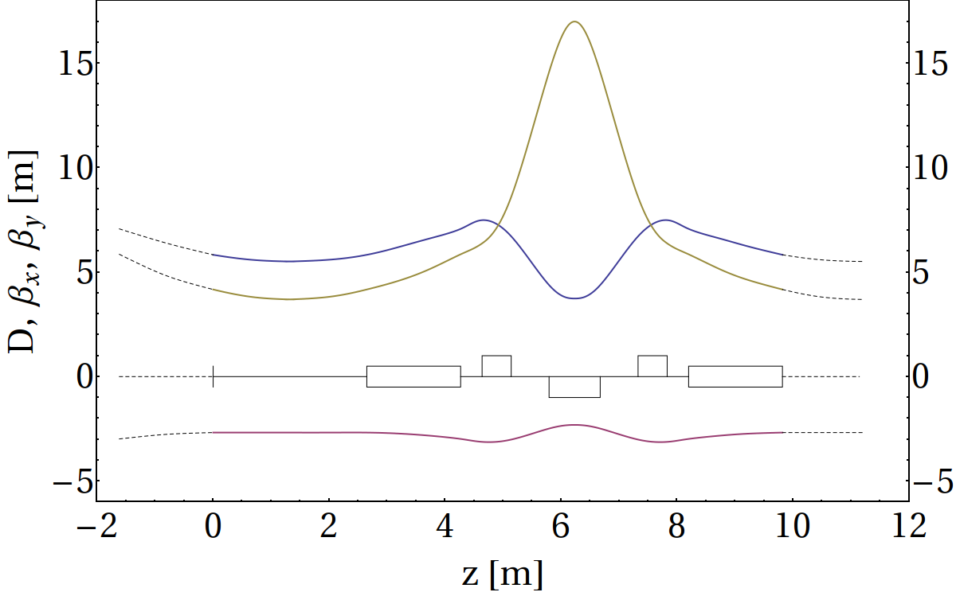
Active compensation
The compensation can also be accomplished with additional quadrupolar components at appropriate phases outside the injection section.
The constraint on the betatron phase advance between perturbation and compensation is:
The additional trim magnets will be at the defocusing quads in period 3 and 14 with:
Chicane fall within 5 ms.
The trim power supplies
have to follow a pre-
programmed function.
Regular Booster
period
β_{y}
β_{x}
L1
B1
QF
QD
QF
B2
D_{x}

Slide 12
Horizontal painting
Painting is a filling scheme for the phase ellipses which can be used for multi turn injections.
Injected beam
x'
x
X_{off}(t₁)
x
X_{off, max}
X_{off}(t₁)
t₁
t
X_{off, max}

Slide 13
Longitudinal painting
The longitudinal painting can be achieved with varying energy offsets.
For the simulations, an energy deviation of ± 1.1 MeV and a period length of 20 turns was assumed.

Slide 14
Table of contents
Brief introduction to the accelerators
Motivation for Linac4
H⁻ charge exchange injection
Compensation schemes
Simulations
Scattering models
Quadrupole resonances
Passive compensation
Comparison of active and passive compensation
Imperfect active compensation

Slide 15
Simulations with ORBIT
ORBIT is a particle tracking program written at the SNS laboratory to simulate H⁻ charge exchange injection.
Multiple processing can be used.
Direct space charge calculations are implemented.
The settings for the simulations were:
Direct space charge effects, apertures, scattering at the injection foil and acceleration were included.
Transversal and longitudinal painting schemes were applied. To this end, initial particle distribution was read from external files.
All simulations were carried out for a high intensity beam with 1.6 10¹³ protons per bunch, represented by 500 000 macro particles and injected to the Booster within 100 turns.
The particle distribution was generated with Mathematica which was also used for the evaluation of the data.
IS IT FEASIBLE TO KEEP THE VERTICAL INJECTION TUNE ABOVE THE HALF-INTEGER RESONANCE AT 2QV = 9?
5/11/2010 CERN Accelerator Physics Forum
Matthias Scholz
15

Slide 16
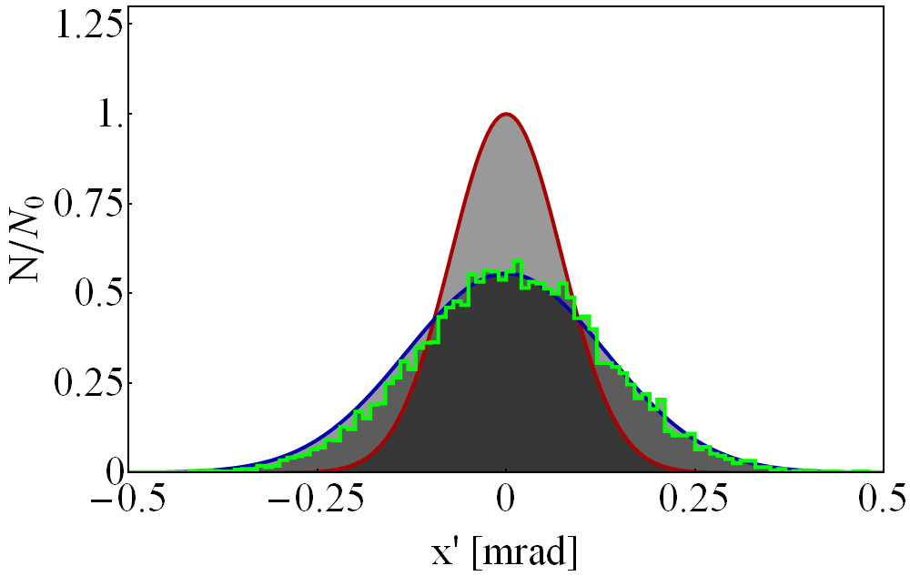
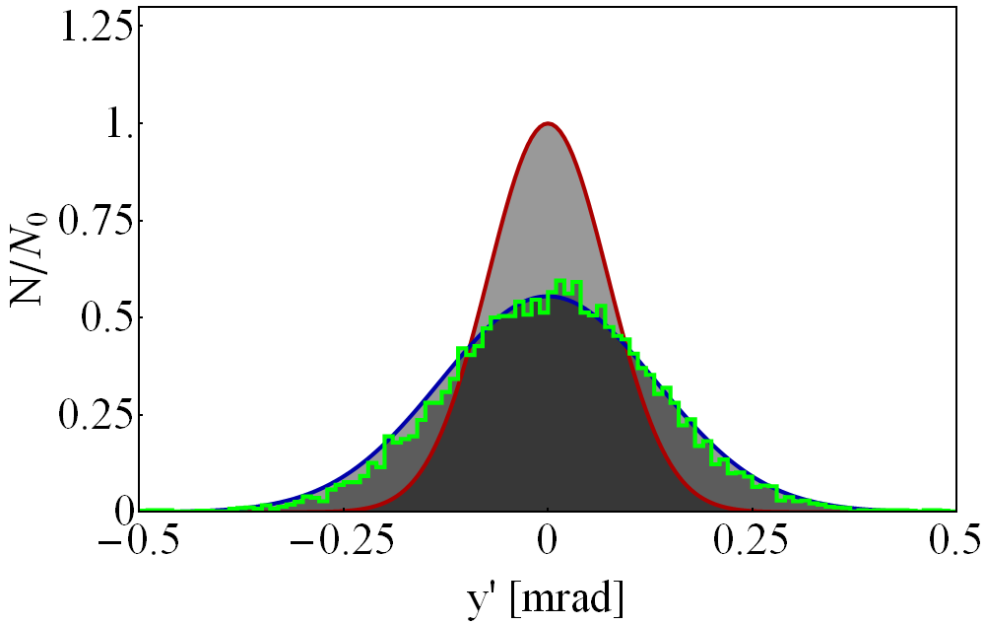
Scattering models for the injection foil
Two different scattering models are available in ORBIT.
σ = 0.0953
σ = 0.0876
Model 1
σ = 0.1587
σ = 0.1387
Model 2

Slide 17
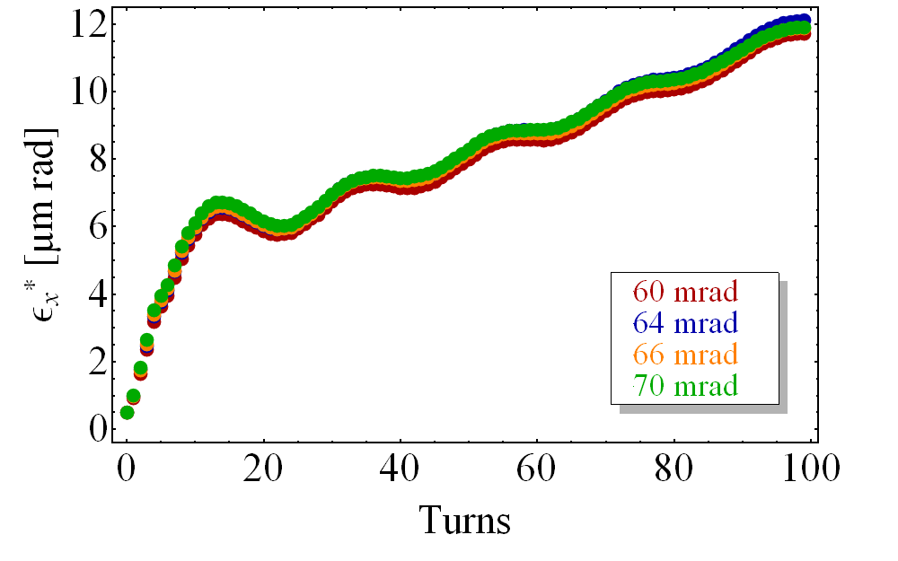
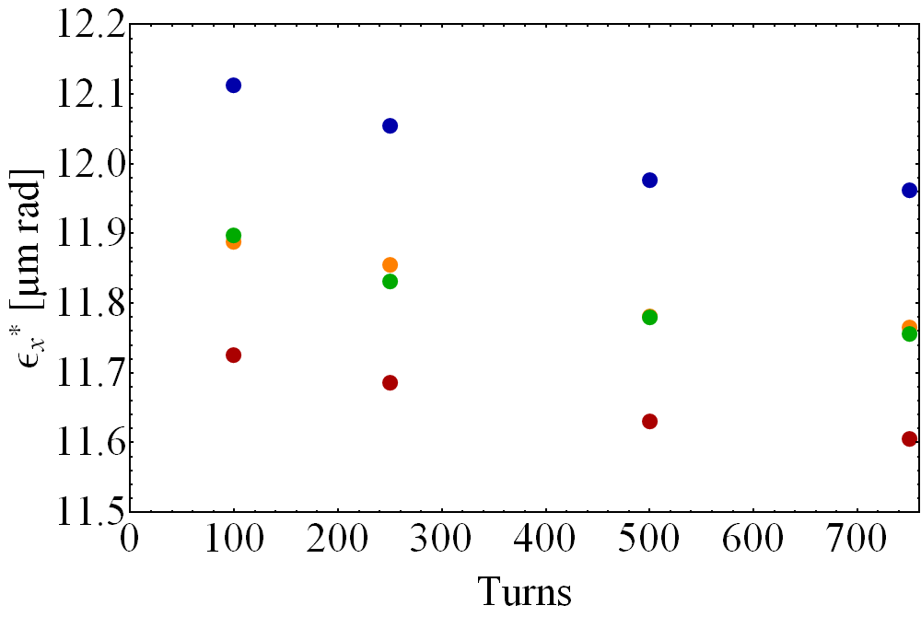
Passive compensation scheme, ε_{x}*
To find the best setting for the pole face rotations, leading to the smallest loss rates during injection and chicane fall, several simulation were carried out.

Slide 18
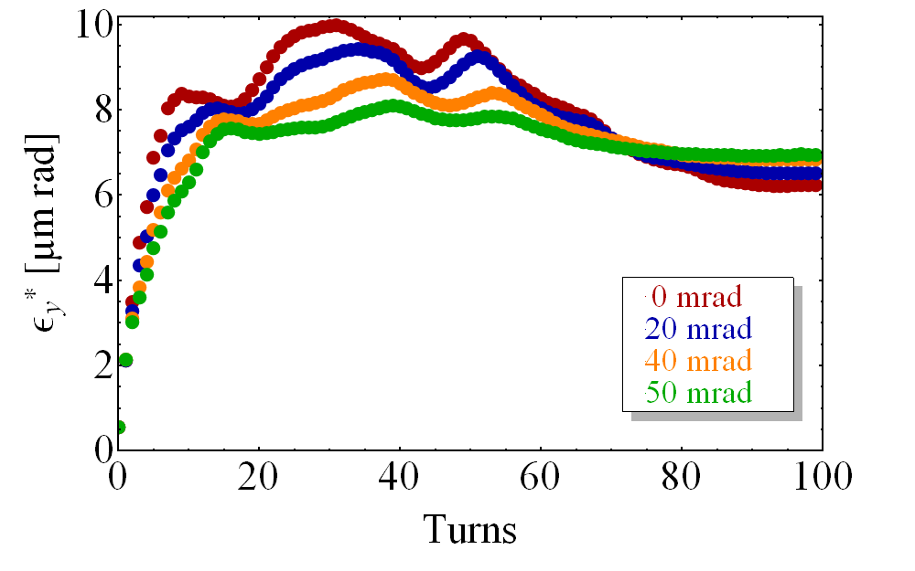
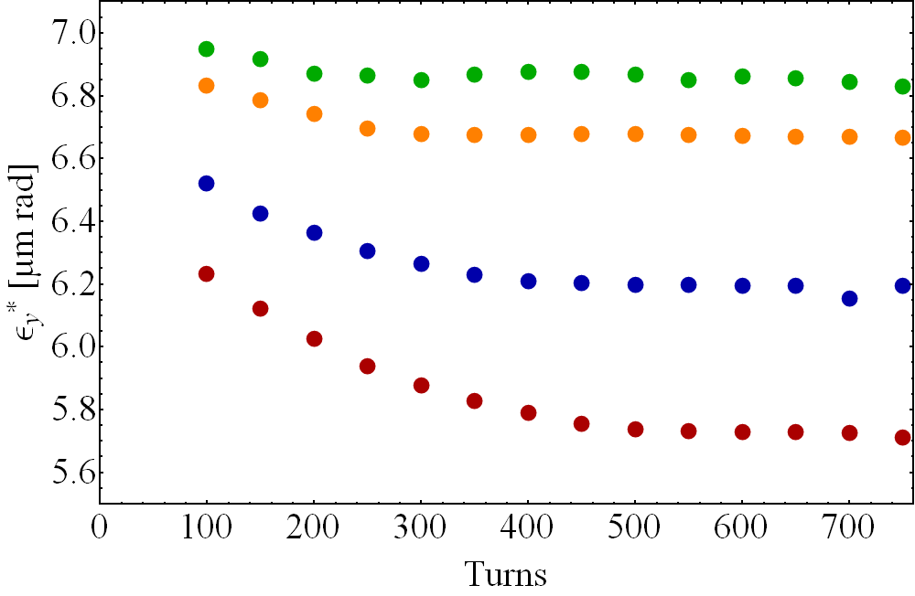
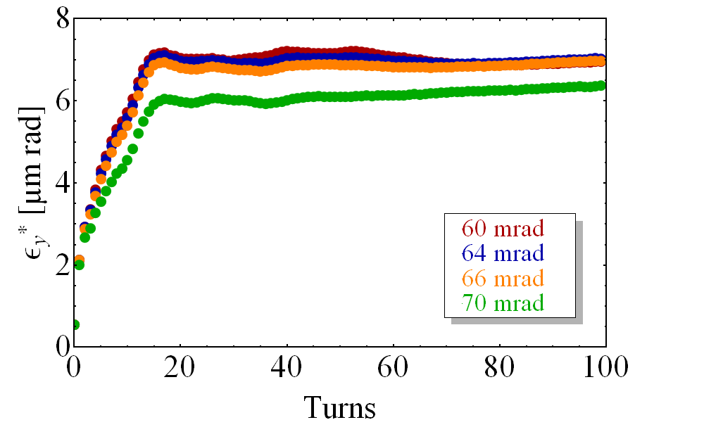
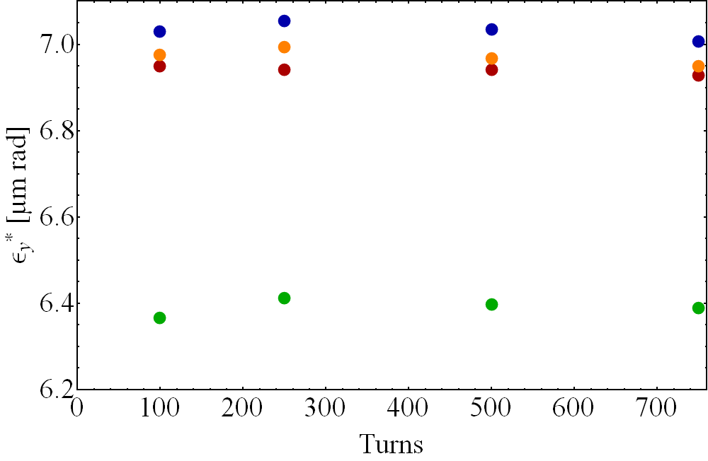
Passive compensation scheme, ε_{y}*
Fast shrinking emittances for small angles indicate high loss rates.
The emittances evolution for angles between 60-70 mrad is almost the same.

Slide 19
Losses with the passive compensation scheme
The loss rates for the applied angles of the pole face rotations up to 750 turns.
The loss rates for the angles between 0 and 50 mrad are much higher than those for 60 to 70 mrad.
The losses for 70 mrad (applying a 66 mrad deflection in the BS magnets) are the smallest after 750 turns, but this is caused by too small emittances.
Further simulations for the passive compensation were executed with a pole face rotation of 64 mrad.

Slide 20
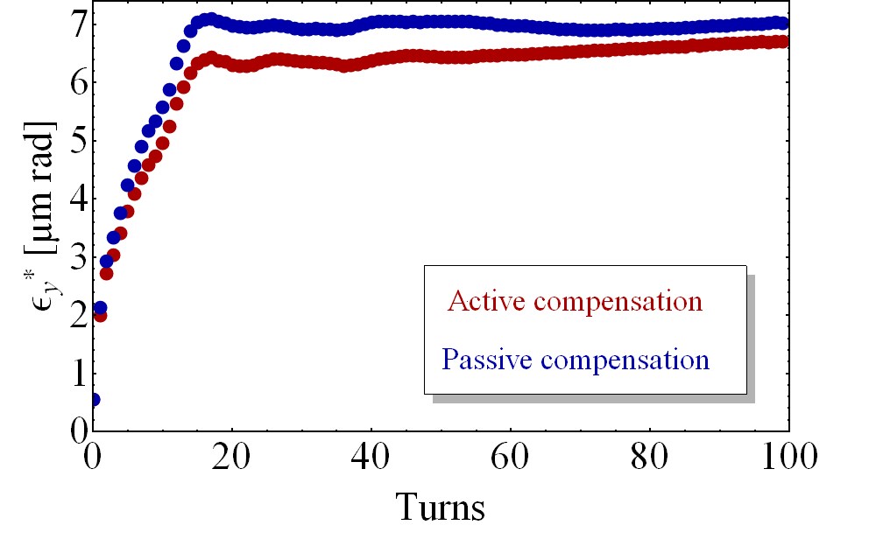
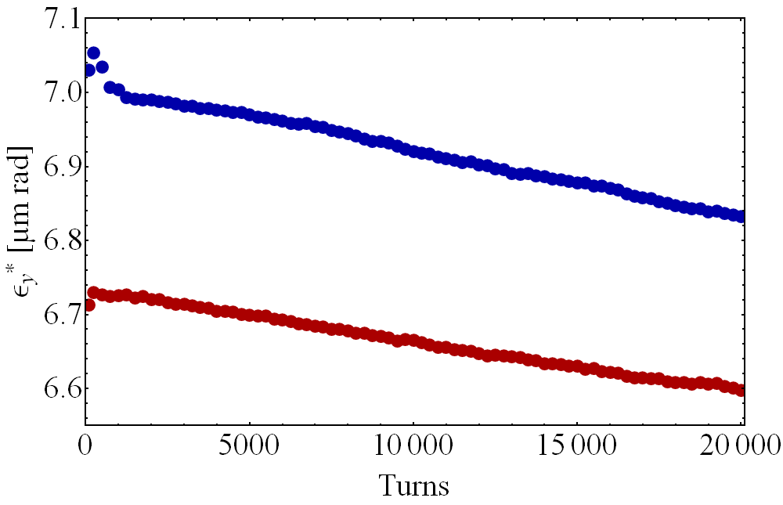
Comparison of active and passive comp, ε*
Both compensation schemes were compared to explore the differences. This simulation was carried out up to 20 000 turns.
The decreasing normalized emittances are due to particle losses.

Slide 21
Comparison of active and passive comp, losses
The loss rates for the active and passive compensation schemes are different during injection and chicane fall, but almost the same after 750 turns.
Both compensation schemes seems to be feasible for the higher vertical injection tune above the half-integer resonance at 2Q_{v} = 9.
During injection and chicane fall, the loss rates for the active compensation are smaller than for the passive compensation scheme.

Slide 22
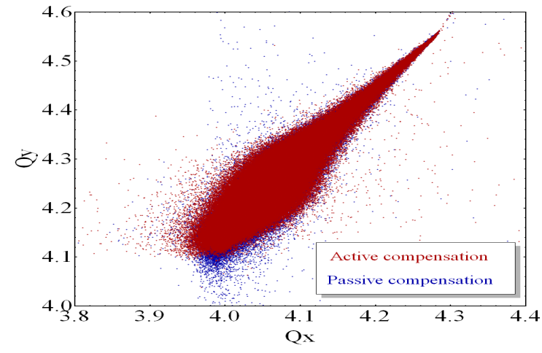
Comparison of active and passive comp, ΔQ
Tune Foot print after 20 000 turns for the active and the passive scheme.

Slide 23
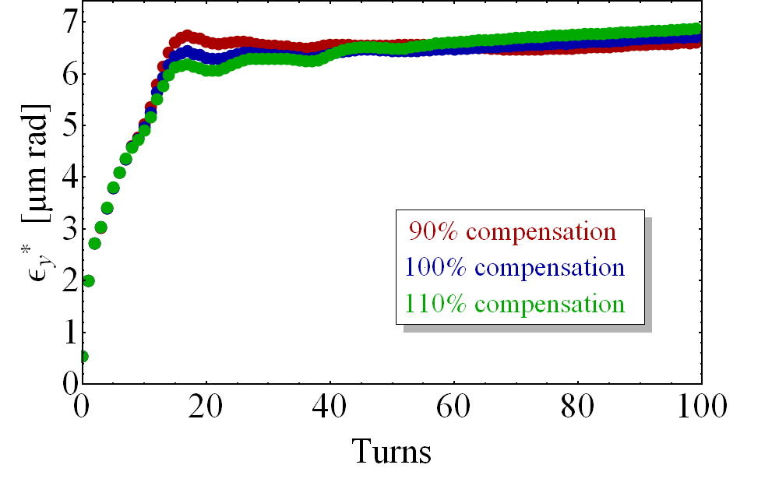
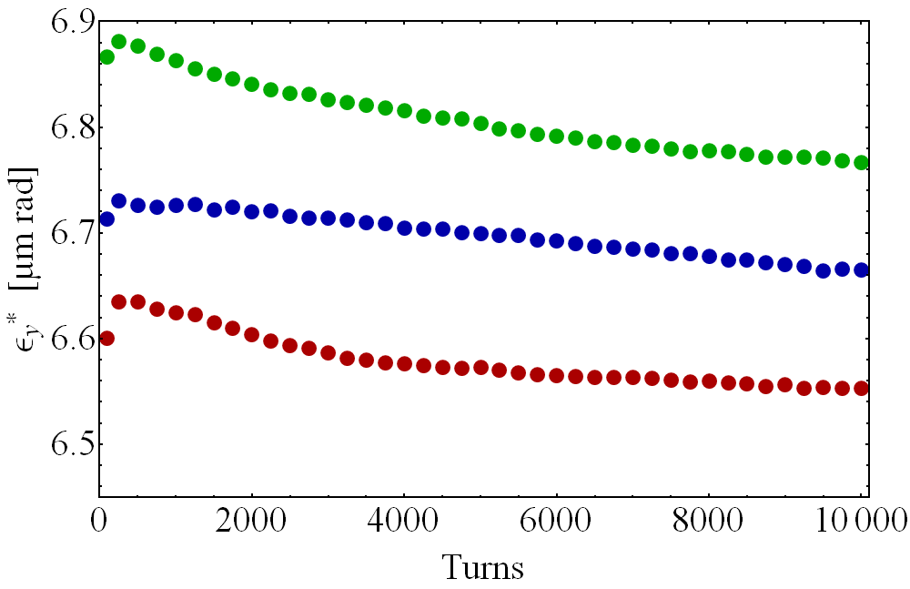
Imperfect active compensation scheme, ε*
Investigation of the Booster performance for imperfect active compensation.
To this end, two simulations with trim gradients of 90% and 110% were carried out.

Slide 24
Losses for the imperfect active compensation
For the imperfect setting of the trim gradients within a range of ±10%, more particles were lost during the simulation than for a perfect compensation case, but the scheme is still feasible.
The 110% compensation leads to 30% more losses and the 90% compensation doubled the number of lost particles.

Slide 25
Conclusions and prospects
For both compensation schemes, it is feasible to keep the injection tune above the half-integer resonance at 2Qv = 9.
The active compensation scheme leads to less losses than the passive compensation scheme during injection and chicane fall.
After 750 turns, the loss rates for both schemes are almost the same.
The active compensation scheme requires additional power supplies for the trim magnets.
The power supplies for the chicane used with the passive compensation scheme have to be roughly 10 times faster than those for the active scheme.
The fast chicane fall used with the passive scheme will lead to induced currents in the vacuum chamber. To this end, a ceramic vacuum chamber will be necessary.
Once built, the passive compensation scheme will be fixed whereas the active scheme can be easier adapted to new conditions.
Many simulations are already run for the LHC nominal beam.
Possible further simulations: Machine imperfections and multipolar components in the BS magnets, injection painting schemes…

Slide 26
Table of contents
Brief introduction to the accelerators
PS Booster
Linac2
Linac4
Motivation for Linac4
H- charge exchange injection
Compensation schemes
Simulations

Slide 27
Proton Synchrotron Booster
The first synchrotron of the LHC proton injection chain.
The PSB is 157 m long and subdivided in 16 periods.
The protons get accelerated up to 1.4 GeV.
4 rings, one upon the other.

Slide 28
Linac2
Drift tube linac based on Alvarez structure.
Accelerates protons up to 50 MeV.
First beam in 1978.

Slide 29
Linac4
Linac4 will replace Linac2 in 2014.
H- ions will be accelerated up to 160 MeV.
A chopper will be implemented to Linac4.
The H- ions will be injected to the Booster via charge exchange injection.
Painting schemes can be used with Linac4

